Slide 1
General Physics
Measurements
Units of Measurement

Slide 2
Measurement
You are making a measurement when you
Check you weight
Read your watch
Take your temperature
Weigh a cantaloupe
What kinds of measurements did you make today?

Slide 3
Standards of Measurement
When we measure, we use a measuring tool to compare some dimension of an object to a standard.

Slide 4
“Standards”
The procedure for verification of the foot as described in the 16th century by Jacob Koebel in his book Geometrei. Von künstlichem Feldmessen und absehen is:^{[41]}
Stand at the door of a church on a Sunday and bid 16 men to stop, tall ones and small ones, as they happen to pass out when the service is finished; then make them put their left feet one behind the other, and the length thus obtained shall be a right and lawful rood to measure and survey the land with, and the 16th part of it shall be the right and lawful foot.

Slide 5
The Fahrenheit scale
the boiling point of water should be 60 degrees. This at least had the strength of numerological tradition behind it (60 minutes in an hour, right?). But zero was totally arbitrary, the main consideration apparently being that it should be colder than it ever got in Denmark. (Romer didn't like using negative numbers in his weather logbook.) In addition to the boiling point of water, the landmarks on Romer's scale were the freezing point of water, 7-1/2 degrees, and body temperature, 22-1/2 degrees.

Slide 6
The second
The unit of time, the second, was defined originally as the fraction 1/86 400 of the mean solar day. The exact definition of "mean solar day" was left to astronomical theories

Slide 7
SI Unit definitions
length meter (m)
The meter is the length of the path travelled by light in vacuum during a time interval of 1/299 792 458 of a second.
mass kilogram (kg)
The kilogram is the unit of mass; it is equal to the mass of the international prototype of the kilogram.
time second (s)
The second is the duration of 9 192 631 770 periods of the radiation corresponding to the transition between the two hyperfine levels of the ground state of the cesium 133 atom.
http://physics.nist.gov/cuu/Units/units.html

Slide 8
Some Tools for Measurement

Slide 9
Learning Check
From the previous slide, state the tool (s) you would use to measure
A. temperature ____________________
B. volume ____________________
____________________
C. time ____________________
D. weight ____________________

Slide 10
Solution
From the previous slide, state the tool (s) you would use to measure
A. temperature thermometer
B. volume measuring cup, graduated cylinder
C. time watch
D. weight scale

Slide 11
Measurement in Science
In chemistry we
do experiments
measure quantities
use numbers to report measurements

Slide 12
Learning Check
What are some U.S. units that are used to measure each of the following?
A. length
B. volume
C. weight
D. temperature

Slide 13
Solution
Some possible answers are
A. length inch, foot, yard, mile
B. volume cup, teaspoon, gallon, pint, quart
C. weight ounce, pound (lb), ton
D. temperature °F

Slide 14
Metric System (SI)
Is a decimal system based on 10
Used in most of the world
Used by scientists and hospitals

Slide 15
Units in the Metric System
length meter m
volume Decimeter cubed dm³
mass Kilogram kg
temperature Celcius °C
Kelvin K

Slide 16
Stating a Measurement
In every measurement there is a
Number
followed by a
Unit from measuring device

Slide 17
Learning Check
Identify the measurement in metric units.
A. John’s height is
1) 1.5 yards 2) 6 feet 3) 2 meters
B. The volume of saline in the IV bottle is
1) 1 decimeter cubed 2) 1 quart 3) 2 pints
C. The mass of a lemon is
1) 12 ounces 2) 145 grams 3) 0.6 pounds

Slide 18
Solution
A. John’s height is
3) 2 meters
B. The volume of saline in the IV bottle is
1) 1 liter
C. The mass of a lemon is
2) 145 grams

Slide 19
Prefixes
You already use these a lot kilo – metre, milli – amp, Mega - byte
But what is a Giga-Watt?
Or a femto-gram?

Slide 20
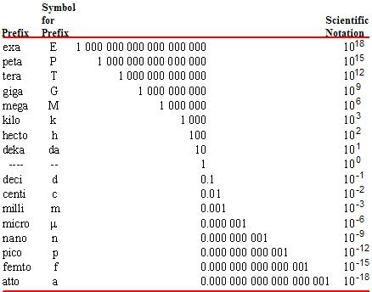
Learn these

