Slide 1
Electronic systems
(a) show an understanding that an electronic sensor consists of a sensing device and a circuit that provides an output voltage
(b) show an understanding of the change in resistance with light intensity of a light-dependent resistor (LDR)
(c) sketch the temperature characteristic of a negative temperature coefficient thermistor
(d) show an understanding of the action of a piezo-electric transducer and its application in a simple microphone
(e) describe the structure of a metal-wire strain gauge
(f) relate extension of a strain gauge to change in resistance of the gauge
(g) show an understanding that the output from sensing devices can be registered as a voltage

Slide 2
Sensors
LDR (203)
Thermistor (199)
Strain gauge (203)
Potential divider (p210)

Slide 3
Operational Amplifiers
(h) recall the main properties of the ideal operational amplifier (op-amp)
(i) deduce, from the properties of an ideal operational amplifier, the use of an operational amplifier as a comparator
(j) show an understanding of the effects of negative feedback on the gain of an operational amplifier
(k) recall the circuit diagrams for both the inverting and the non-inverting amplifier for single signal input
(l) show an understanding of the virtual earth approximation and derive an expression for the gain of inverting amplifiers.
(m) recall and use expressions for the voltage gain of inverting and of non-inverting amplifiers.

Slide 4
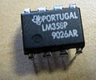
What is an Op-Amp? – The Surface
An Operational Amplifier (Op-Amp) is an integrated circuit that uses external voltage to amplify the input through a very high gain.
We recognize an Op-Amp as a mass-produced component found in countless electronics.
What an Op-Amp looks like to a lay-person
What an Op-Amp looks like to an engineer

Slide 5
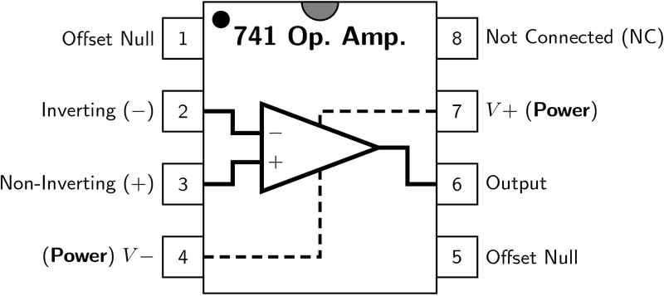
What is an Op-Amp? – The Layout
There are 8 pins in a common Op-Amp, like the 741 which is used in many instructional courses.

Slide 6
What is an Op-Amp? – The Inside
The actual count varies, but an Op-Amp contains several Transistors, Resistors, and a few Capacitors and Diodes.
For simplicity, an Op-Amp is often depicted as this:
Positive Power Supply
Inverting Input
-
Output
Non-Inverting Input
+
Negative Power Supply

Slide 7
History of the Op-Amp – The Dawn
Before the Op-Amp: Harold S. Black develops the feedback amplifier for the Western Electric Company (1920-1930)
Forward Gain
A
Input
Output
β
Feedback

Slide 8
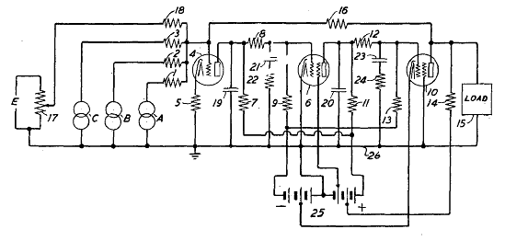
History of the Op-Amp – The Dawn
The Vacuum Tube Age
The First Op-Amp: (1930 – 1940) Designed by Karl Swartzel for the Bell Labs M9 gun director
Uses 3 vacuum tubes, only one input, and ± 350 V to attain a gain of 90 dB
Loebe Julie then develops an Op-Amp with two inputs: Inverting and Non-inverting

Slide 9
History of the Op-Amp – The Shift
The end of Vacuum Tubes was built up during the 1950’s-1960’s to the advent of solid-state electronics
The Transistor
The Integrated Circuit
The Planar Process

Slide 10
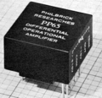
History of the Op-Amp – The Shift
1960s: beginning of the Solid State Op-Amp
Example: GAP/R P45 (1961 – 1971)
Runs on ± 15 V, but costs $118 for 1 – 4
The GAP/R PP65 (1962) makes the Op-Amp into a circuit component as a potted module

Slide 11
History of the Op-Amp – The Evolution
The solid-state decade saw a proliferation of Op-Amps
Model 121, High Speed FET family, etc.
Robert J. Widlar develops the μA702 Monolithic IC Op-Amp (1963) and shortly after the μA709
Fairchild Semiconductor vs. National Semiconductor
National: The LM101 (1967) and then the LM101A (1968) (both by Widlar)
Fairchild: The “famous” μA741 (by Dave Fullager 1968) and then the μA748 (1969)

Slide 12
(h) recall the main properties of the ideal operational amplifier (op-amp)

Slide 13
Mathematics of the Op-Amp
The gain of the Op-Amp itself is calculated as:
G = V_{out}/(V₊ – V₋)
The maximum output is the power supply voltage
When used in a circuit, the gain of the circuit (as opposed to the op-amp component) is:
A_{v} = V_{out}/V_{in}

Slide 14
741 Op-Amp Schematic
current mirror
current mirror
voltage level shifter
output stage
differential amplifier
current mirror
high-gain amplifier

Slide 15
Ideal Op-Amp Characteristics
Open-loop gain G is infinite
R_{in} is infinite
Zero input current
R_{out} is zero
Infinite bandwidth (same amplification for all frequencies)
Infinite slew rate (How fast the op amp reacts)

Slide 16
Op-Amp Characteristics
Open-loop gain G is typically over 9000
But closed-loop gain is much smaller
R_{in} is very large (MΩ or larger)
R_{out} is small (75Ω or smaller)
Effective output impedance in closed loop is very small

Slide 17
Ideal Op-Amp Analysis
To analyze an op-amp feedback circuit:
Assume no current flows into either input terminal
Assume no current flows out of the output terminal
Constrain: V₊ = V₋

Slide 18
(i) deduce, from the properties of an ideal operational amplifier, the use of an operational amplifier as a comparator

Slide 19
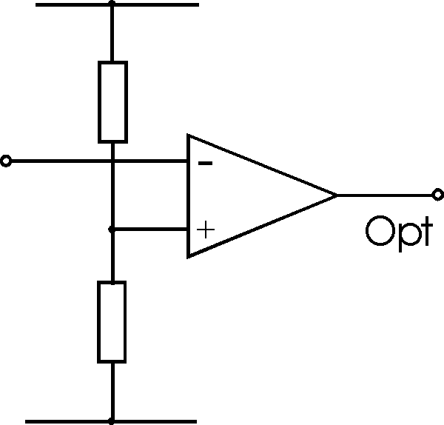
Basic comparator
Vo=Ao(V⁺-V⁻)
Ao is very large
So output is usually saturated
Polarity depends on which input has biggest magnitude

Slide 20
Op-Amp Saturation
As mentioned earlier, the maximum output value is the supply voltage, positive and negative.
The gain (G) is the slope between saturation points.
V_{out}
V_{s}⁺
V_{in}
V_{s}⁻

Slide 21
Basic comparator
The potential divider provides a fixed input to V+
The V- input will “be compared”
If V in is larger than V+ output is negative
Try some values with the equation eg V+= 5V Vin= 5.5V (assume an open loop gain of 10⁵)
What happens when Vin is less than V+?

Slide 22
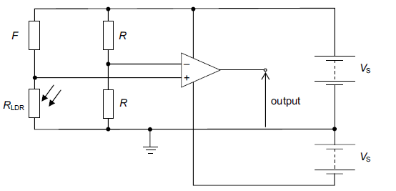
Using a potential divider to provide Vin
By using a potential divider circuit connected to the same power supply as the reference input.

Slide 23
To do
Draw a circuit using an operational amplifier to provide a positive output when it is hot and a negative output when it is cold.
Try the past paper question (Nov 2007 p4q9)

Slide 24
(j) show an understanding of the effects of negative feedback on the gain of an operational amplifier
(k) recall the circuit diagrams for both the inverting and the non-inverting amplifier for single signal input

Slide 25
Inverting Amplifier Analysis
virtual earth
To avoid saturation Vin must be very nearly equal to V+ (i.e. V) Hence virtual earth

Slide 26
Inverting Amplifier Analysis
virtual ground
Since impedence of the op amp is very high no current flows through the device.
Current through Rin=Current through Rf
Positive values of Vin give –ve output values and vice-versa. (Can you use the equation to show why?)

Slide 27
Inverting Amplifier Analysis
Iin+If
V_{(Rin)}/Rin=V_{(Rf)}/Rf
Since P=OV
V_{(Rin)=} Vin-0
V_{(Rf)=} 0-Vout
So Vout/Vin=-Rf/Rin
P (virtual ground)

Slide 28
To do
Look cover check the derivation.
Explain in a simple paragraph what is meant by “virtual earth” (hint use bullet points)
Try questions from Understanding Physics (p529 25.5 +25.6, p547 EM19 +20)

Slide 29
Non-Inverting Amplifier Analysis

Slide 30
Op-Amp Summing Amplifier

Slide 31
Op-Amp Differential Amplifier
If R₁ = R₂ and R_{f} = R_{g}:

Slide 32
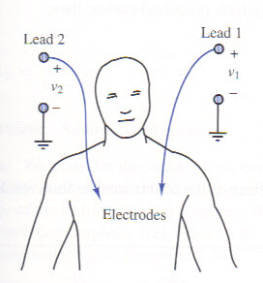
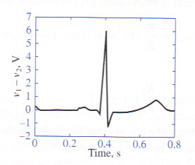
Applications of Op-Amps
Electrocardiogram (EKG) Amplification
Need to measure difference in voltage from lead 1 and lead 2
60 Hz interference from electrical equipment

Slide 33
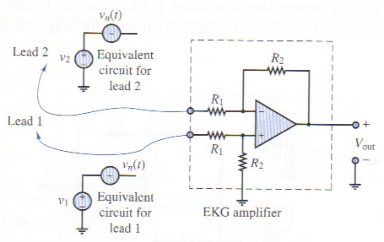
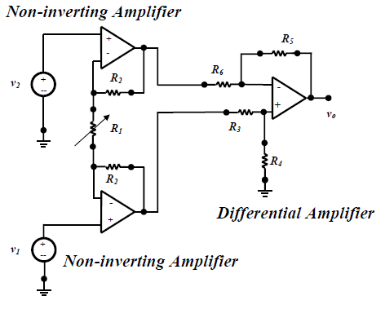
Applications of Op-Amps
Simple EKG circuit
Uses differential amplifier to cancel common mode signal and amplify differential mode signal
Realistic EKG circuit
Uses two non-inverting amplifiers to first amplify voltage from each lead, followed by differential amplifier
Forms an “instrumentation amplifier”

Slide 34
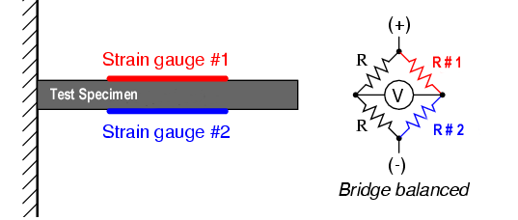
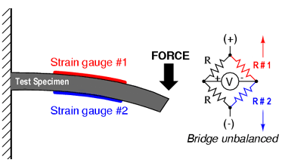
Strain Gauge
Use a Wheatstone bridge to determine the strain of an element by measuring the change in resistance of a strain gauge
(No strain) Balanced Bridge
R #1 = R #2
(Strain) Unbalanced Bridge
R #1 ≠ R #2

Slide 35
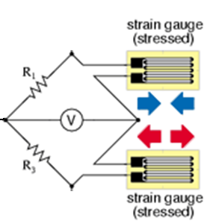
Strain Gauge
Half-Bridge Arrangement
Op amp used to amplify output from strain gauge
R + ΔR
R_{f}
R
V_{ref}
+ V_{cc}
+
-
+
+
V₀
__
-
R
- V_{cc}
R - ΔR
R_{f}
Using KCL at the inverting and non-inverting terminals of the op amp we find that ➔
ε ~ V_{o} = 2ΔR(R_{f} /R²)

Slide 36
References
Cetinkunt, Sabri. Mechatronics. Hoboken, NJ: John Wiley & Sons Inc., 2007.
Jung, Walter G. Op Amp Applications Handbook. Analog Devices, Inc., 2005.
“Operational Amplifier.” http://en.wikipedia.org/wiki/Operational_amplifier.
“Operational Amplifier Applications.” http://en.wikipedia.org/wiki/Operational_amplifier_applications.

Slide 37
References
Rizzoni, G. Principles and Applications of Electrical Engineering, McGraw Hill, 2007.
http://web.njit.edu/~joelsd/electronics/Labs/ecglab.pdf

Slide 38
Output
(n) show an understanding of the use of relays in electronic circuits
(o) show an understanding of the use of light-emitting diodes (LEDs) as devices to indicate the state of the output of electronic circuits
(p) show an understanding of the need for calibration where digital or analogue meters are used as output devices.

Slide 39
Objectives
Know the definition of a relay
Understand relay operating principles
Properly test relay operation

Slide 40
Relay Principles
A relay may also be called an “electromagnetic switch”
Relays use a “low current circuit” to control a “high current circuit”
The low current circuit controls an electromagnetic device
The electromagnetic device “closes/opens” the high current circuit

Slide 41
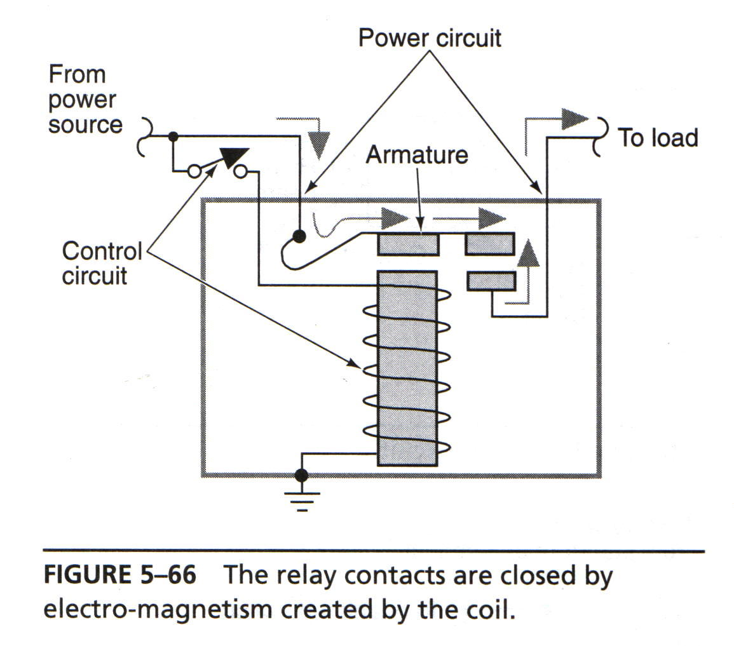
Relay Operation

Slide 42
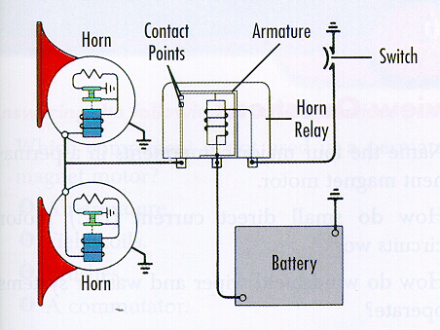
Relay Applications

Slide 43
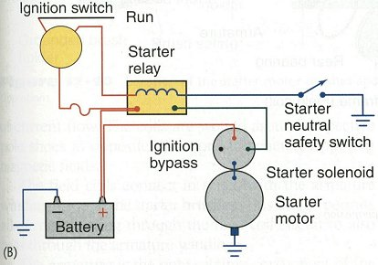
Relay Applications

Slide 44
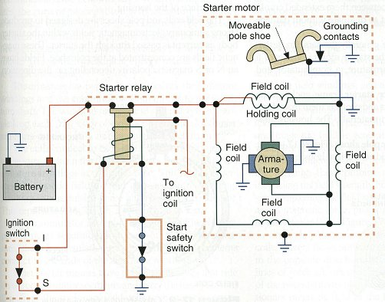
Relay Applications

Slide 45
REVIEW...
WHY ARE RELAYS CALLED MAGNETIC SWITCHES?
HOW MUCH CURRENT DOES THE CONTROL CIRCUIT USE?
HOW MUCH CURRENT DOES THE LOAD CIRCUIT USE?
NAME SOME ADVANTAGES OF USING RELAYS?

Slide 46
Elizabethtown Technical College BEX100 – Basic Electricity

