Slide 1
exponential decay
State that radioactive decay is a random and spontaneous process and that the rate of decay decreases exponentially with time.
Define the term radioactive half-life.
Determine the half-life of a nuclide from a decay curve.
Solve radioactive decay problems involving integral numbers of half lives.

Slide 2
Prior knowledge
Basic, descriptive radioactivity should already have been covered. Students will have previously been introduced to the term half-life, but are unlikely to be confident in using the quantity in calculations.

Slide 3
To do
Draw a graph of the coin experiment
Make notes on half life and decay using text book pages 462. (Especially methods to determine half life).

Slide 4
Plotting a graph
The definition of half life T_{1/2}. The half life of a radioactive substance is the time taken on average for half of any quantity of the substance to have decayed. (Halving time is ok for IB.)
We use the term exponential to describe this behaviour, in which a quantity decreases by a constant factor in equal intervals of time.
Exponential behaviour in nature is very common.
the reduction in amplitude of a damped simple harmonic oscillator;
the absorption of electromagnetic radiation passing through matter (e.g. g rays by lead, visible light by glass)
Newton’s Law of Cooling.

Slide 5
Example
Question: The nuclear industry considers that after 20 half lives, any radioactive substance will no longer present a significant radiological hazard. The half life of the fission product from a nuclear reactor, caesium-137, is 30 years. What fraction will still be active after 20 half lives?
Answer: Use the long method. Calculate 1/2 of 1/2 and so on for twenty steps:
1/2, 1/4, 1/8, 1/16, 1/32, …, 1/1024 after 10 half lives
1/2048, …, 1/1048576 after 20 half lives
i.e. less than one millionth of the original quantity remains radioactive.
A quicker method is to calculate (1/2)²⁰. This is done with a calculator, using the y^{x} key.
Question: How many years into the future will Cs-137 be “safe”?
Answer: 20 × 30 = 600 years
Question: If after ten half lives the activity of a substance is reduced to one thousandth of its original value, how many more half lives must elapse so that the original activity is reduced to one millionth of its original value?

Slide 6
To answer more difficult questions you will need the relationship between half life and decay constant
t1/2 = ln2/λ

Slide 7
Half life questions
The half-life of strontium-90 is 27 years. The half-life of sodium-24 is 15 hours.
1. Sketch two curves on one set of axes to show how the number of atoms of each change with time. Two samples are prepared, one containing 10²⁰ atoms of strontium and the other containing 10²⁰ atoms of sodium.
2. Which of the two samples has the highest activity? 3. A sample of iodine-131, with half-life 8.0 days, has an activity of 7.4 x 10⁷ Becquerel (Bq). Calculate the activity of the sample after 4 weeks and 4days? 4. ²³⁴Th has a half life of 24.1 days.
(a) What fraction of a sample remains after 96.4 days?
(b) What fraction of a sample remains after 241 days?

Slide 8
Answers
Sodium, since a longer half-life means the source is less active.
4
(a) 96.4/24.1=4 so 4 half lives so (1/2)⁴ = =1/16 or .0625
(b) 241/24.1=10 so 10 half lives (1/2)¹⁰ = 1/1024 or 9.8 x 10⁻⁴

Slide 9
Further questions
P 465 q 14

Slide 10
Summary – can you
Define the term half-life.
Make calculations involving numbers of half-lives.
Relate half-life to decay probability.
Measure the half-life of a fast-decaying nuclide.

Slide 11
Measuring short half lives
A short half-life source commonly available in schools and colleges is protactinium-234, T_{1/2} = 72s. Another is radon-220, T_{1/2} = 55s.
Take readings from the GM tube as frequently as you can accurately manage until the count rate is the same as the background count.
Subtract the effects of background radiation from your readings.
This is the corrected count rate (CCR); it corresponds to the activity of the sample.
Plot a graph of corrected count rate against time and a graph of log(CCR) against time.

Slide 12
Aims
define the terms activity and decay constant and recall and solve problems using A = λN
infer and sketch the exponential nature of radioactive decay and solve problems using the relationship x = x₀exp(–λt), where x could represent activity, number of undecayed particles or received count rate
solve problems using the relation
λ = 0. 693/t_{1/2}

Slide 13
Some definitions
A is the activity of a sample of radioactive material. It is the number of decays per unit time.
λ is the decay constant. It is the probability of a particular nucleus decaying per unit time
Eg if 2million particles from a sample of 1 billion decay in 1min.
the activity is:
2.0x10⁶/60 Bq (1Bequerel = 1 decay per second)
The decay constant is:
2.0x10⁶/1.0x10⁹ = 0.0020 min⁻¹ = 3.3x10⁻⁵s⁻¹

Slide 14
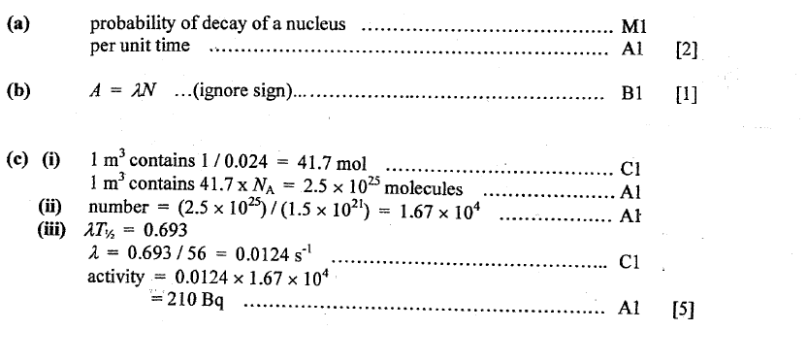
Ppq 1

Slide 15
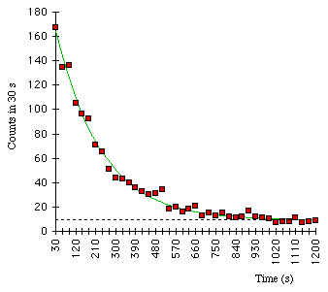
Equation of exponential decay
A: decay rate or Activity
λ: decay constant
τ: decay time (=1/λ)

Slide 16
Show that the decay constant is related to the half-life t _{½} by the expression t _{½} = 0.693.
Using x = x₀e^{(–λt)}
And at t _{½} , x= ½x₀
½x₀ = x₀e^{(–λt1/2)}
½ = e^{(–λt1/2)}
ln ½ = –λt_{1/2}
- 0.693 = –λt_{1/2}
0.693 = λt_{1/2}
QED

Slide 17
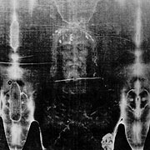
¹⁴C dating
¹⁴C is produced from ¹⁴N by Cosmic
rays. While alive, organisms have
a fixed ¹²C/¹⁴C ratio (1/1.3x10⁻¹²)
(Carbon in CO₂).
After dying, no more ¹⁴C is absorbed
and it decays away and the ratio of
¹²C/¹⁴C can be used for dating.
Found to be from 1320±60
Shroud of Turin

Slide 18
To do.
P464 q11&17

