Slide 1
Atomic models
27.(b) describe a simple model for the nuclear atom to include protons, neutrons and orbital electrons.
27.(a) infer from the results of the –particle scattering experiment the existence and small size of the nucleus.

Slide 3
Atomic models
Plum pudding Thompson
Rutherford’s model 1914
Bohr’s model 1920
Schroedinger’s model 1924
http://js082.k12.sd.us/My_Classes/Physical_Science/atoms/atoms_1.htm

Slide 4
The electron
in 1897 J.J Thompson set about examining a flow of electricity, this is what are called cathode rays where electricity is propelled across a vacuum by a potential difference.
Thomson showed that the stream could be deflected by both electric and magnetic fields and from this deduced that whatever was flowing must have a negative charge.
This led to the idea of the cathode ray being a stream of particles which we now call electrons.
Thomson went further than this he developed his own model of the atom, in order to account for the electrically neutral complete atom he proposed a sphere of positive charge to counter the electrons. The electrons were free to move around in this charge as though it were a kind of liquid a very popular concept at the time.

Slide 5
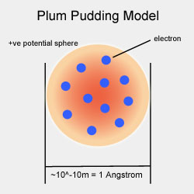
Thompson’s model

Slide 6
More experiments
In the early 1900's Mr. Ernest Rutherford designed his famous experiment it involved shooting alpha particles.
He collimated the alpha particles using slits then fired them at a thin sheet of gold only a few atoms thick.
Rutherford expected that the atoms would pass straight through with very little deviation in accordance with the plum pudding model.

Slide 7
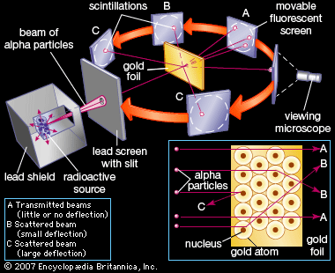
Rutherford’s experiment

Slide 8
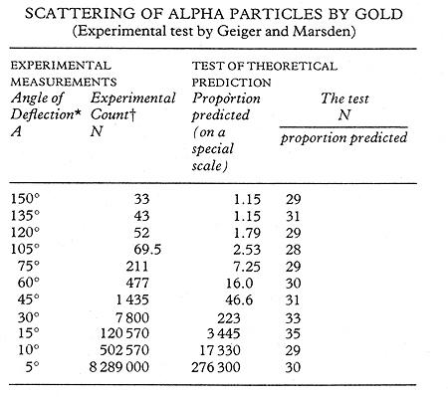
The results
Geiger and Marsden's table of results compared with predictions using Rutherford's model.

Slide 9
A new model
What they actually detected was backscattering or deflection at angles > 90 degrees.
This would be incompatible with the pudding model of Thomson.
By counting the number of impacts on a phosphorous screen he found that ~ 1/1000 of α particles were deflected at angles > 90 degrees.
In 1911 Rutherford proposed a theory where instead of being distributed over the whole atom the positive charge was condensed into a very small nucleus at the centre of the atom surrounded by orbiting electrons(This became known as the Nuclear model).

Slide 10
To do
Read p329
Worksheet Q

Slide 11
Problems with the model
There was one very obvious problem with Rutherfords model and that lay in the well established laws of classical electrodynamics.
These laws stated that any accelerating charge would produce electromagnetic radiation.
Since the electron accelerates radially as it orbits the nucleus, energy would be radiated away from the electron causing its orbit to decay.
From observing atomic densities and calculating the time for these orbits to decay based on classical theories it was very clear this wasn't happening.

Slide 12
Energy levels
Neils Bohr in 1913 took the step of incorporating recent developments in quantum ideals into a model of the Hydrogen atom.
What he proposed was basically the Rutherford planetary system but he postulated that the orbits would remain stable at certain quantized radii due in turn to quantized angular momentum.
He also said that the only way the orbit could change is if it were to jump from one quantum state to another with no intermediate stages.
The previously observed Rydberg emission lines of hydrogen were explained almost perfectly by his theory and thus he formed one of the most influential theories of modern physics.

Slide 13
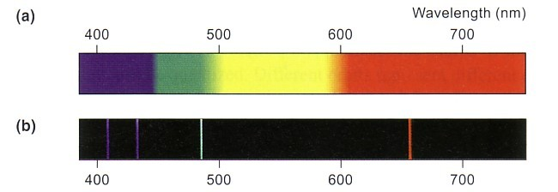
Hydrogen atom emission spectrum give us hints …
is a continuous spectrum obtained from visible light, λ from 400nm to 700 nm.
is a line spectrum obtained from emitted light of an excited hydrogen atom, λ from 400 nm to 700 nm.

Slide 14
Bohr’s enlightenment
E₁ = 3.03 x 10⁻¹⁹ J
E₂ = 4.09 x 10⁻¹⁹ J
E₃ = 4.58 x 10⁻¹⁹ J
E₃ = 4.58
n = 4
n = shell number
n is also called principal quantum number
n = 3
E₂ = 4.09
n = 2
E₁= 3.03
n = 1
Features of energy levels of H atom:
1.discrete / 2.energy gap decreasing

Slide 15
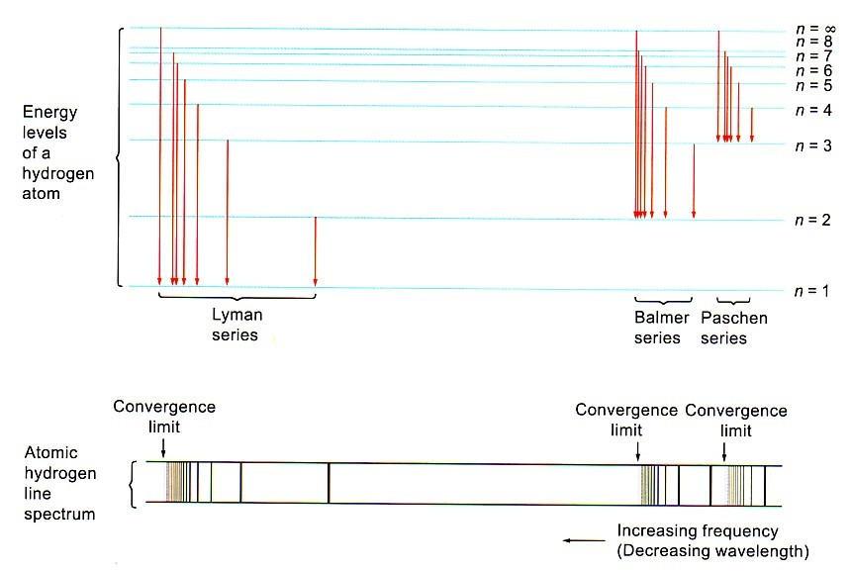
Bohr model:electronic structure of hydrogen atom

Slide 16
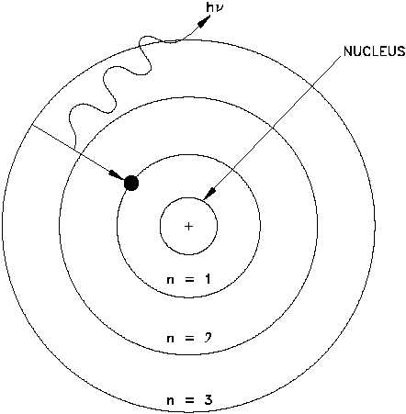
The Bohr Model

Slide 17
Not the end……
There are some clear limitations of the theory though
The fact that it does not predict decay rates/intensity of emission
The fact that it doesn’t explain the spectra too well for larger atoms than Hydrogen.
www.uk-astronomy.com/atom.htm

Slide 18
To do
Read p330
Worksheet Q

Slide 19
Homework
Visit the website http://js082.k12.sd.us/My_Classes/Physical_Science/atoms/atoms_1.htm
If you took one page of your notebook as one atom what would be the width of
A proton
An electron

