Slide 1
SECTION V: Electricity and magnetism
19. Current of electricity

Slide 2
Current and charge

Slide 3
19. Current of electricity
19.1 Electric current:
(a) show an understanding that electric current is the rate of flow of charged particles
(b) define charge and the coulomb
(c) recall and solve problems using the equation Q = It

Slide 4
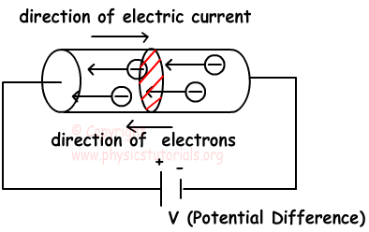
19. Current of electricity
If we connect a conductor to a battery, free charges inside this
electric field are exerted an electric force F.
Under the effects of this force
electrical charges starts to flow.
This rate of flow of charged
particles is called electric current.

Slide 5
19. Current of electricity
The electric charge is a propertie of the matter.
Electric charge exist in 2 ways: positive charge and negative charge.
The size of electric charge called a coulomb (C).
1 mC = 1 mili coulomb = 10⁻³ C
1 μC = 1 micro coulomb = 10⁻⁶ C
1 nC = 1 nano coulomb = 10⁻⁹ C
electron charge = - 1.6 x 10⁻¹⁹ C = elemental charge

Slide 6
19. Current of electricity
Current I is found with the following formula;
Where: I is the current.
Q is the electric charge.
t is the time.
The unit of electric current is coulomb per second, and we give specific name ampere (A).

Slide 7
19. Current of electricity

Slide 8
19. Current of electricity
1. Convert 25 mA to A
2. Convert 0.50 A to mA
3. A torch bulb passes a current of 120 mA.
(a) How many coulombs of charge flow through the lamp in 1 minute?
(b) How many coulombs of charge flow through the lamp in 1 hour?
(c) How many electrons leave the negative terminal of the cell each second?
4. A car battery is rated as 36 A h. In principle this means it could pass a current of 1.0 A for 36 h before it runs down. How much charge passes through the battery if it is completely run down?
5. An electron beam in a beam tube carries a current of 125 μA.
(a) What charge is delivered to the screen of the tube every second?
(b) How many electrons hit the screen each second?

Slide 9
Solutions to introductory questions on charge and current
1. 0.025 A
2. 500 mA
3. (a) Q = It = 0.120 × 60 = 7.2 C
(b) Q = It = 0.120 × 60 × 60 = 432 C
(c) N = Q/e = It/e = (0.120 × 1) / 1.6 × 10⁻¹⁹ = 7.5 × 10¹⁷ s⁻¹
4. Q = It = 36 × 60 × 60 = 129 600 = 130 000 (2 sf.)
5.
(a) Q = It = 1.25 × 10⁻⁴ × 1 = 1.25 × 10⁻⁴ C
(b) N = Q/e = 1.25 × 10⁻⁴ / 1.6 × 10⁻¹⁹ = 7.8 × 10¹⁴ s⁻¹

