Slide 1
19.2 Potential difference
(d) define potential difference and the volt.
(e) recall and solve problems using: .
f) recall and solve problems using:

Slide 2
19.2 Potential difference
The POTENTIAL of a place may be thought of as its attractiveness for electrons or unattractiveness for positive charges.
A place where there is a high concentration of electrons it will have a low potential.
The POTENTIAL DIFFERENCE (PD) V between two places is defined as the work done per coulomb of charge moved from the one place to the other.

Slide 3
19.2 Potential difference
Potential difference V is found with the following formula;
Where: V is the potential difference.
W is the work done.
Q is the electric charge.
The unit of potential difference is joule per coulomb, and we give specific name volt (V).

Slide 4
19.2 Potential difference
1. What is the definition of potential difference or voltage? What is its unit?
2. Prove that 1 J is equivalent to 1 V·A ·s.
3. What is the potential difference between two points if 1.0 kJ of work is required to move 0.5 C of charge
between the two points?
4. What is the voltage of a source which provides 12.0 J
to each Coulomb of charge present?
5. What is the potential difference between two points when a charge of 80.0 mC has 4.0 x 10³ J of energy supplied to it as it moves between the two points?

Slide 5
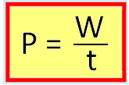
19.2 Potential difference
The ELECTRIC POWER of a device is the rate at which
it transfers energy or it doing an electric work.
Or in symbols:

Slide 6
19.2 Potential difference
ELECTRICAL POWER (P):
W = V Q
W/t = V Q/t
But: P = W/t and Q/t = I
Thus:

Slide 7
19.2 Potential difference
Then the Electric Power P is found with the following formula;
Where: P is the electric power.
V is the potential difference.
I is the current.
The unit of electric power is joule per second, and we give specific name watt (W).

Slide 8
19.2 Potential difference
The ENERGY TRANSFERRED by a device in a certain time
is given by the equation:
Or in symbols:

Slide 9
19.2 Potential difference
The Energy transferred E also is found with the following formula:
Where: P is the electric power. (watts) or (kW)
t is the time. (seconds) or (hours)
E is the energy transferred. ( joule) or (kWh)
The unit of energy transferred is joule or kWh (kilowatt – hour).

Slide 10
19.2 Potential difference
1. A food processor draws 8.47 A of current when connected to a potential difference of 110 V.
a. What is the power consumed by this appliance?
b. How much electrical energy is consumed by this food processor monthly (30 days) if it is
used on average of 10.0 min every day?
c. Assume that the price of electrical energy is 7.00 $/kWh. What is the monthly cost of using
this food processor?
2. The electric meter in a house indicates that the refrigerator consumes 70.0 kWh in a week.
a. What is the power consumption of the refrigerator?
b. Assuming it is connected to a potential difference of 120 V , how much current does the
refrigerator draw?
3. The heating element of an electric broiler dissipates 2.8 kW of power when connected to a potential difference of 120 V.
a. What is the resistance of the element?
b. How much current does the broiler draw? Use two ways to find out, and verify your
answer.

Slide 11
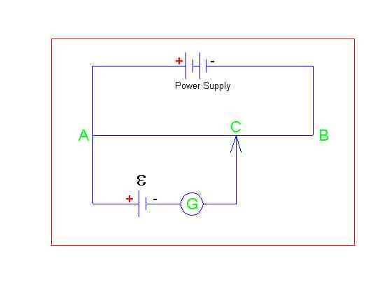
Null methods
A B is a length of wire
C is a moveable contact
G is a galvanometer
E is a source of emf

Slide 12
Calibration
Using a standard cell (known emf)
C is adjusted until Galvanometer reads zero
At this point the circuit is balanced (p.d. across AC = emf).
The length AC is measured
Emf / L gives a value in Vm-1
The circuit is calibrated

Slide 13
Measuring emf
Place unknown emf at E
Find balance point as before
Measure length from A to C (L)
Multiply L by callibration factor to find unknown E.

