Slide 1
19.3 Resistance and resistivity
Learning outcomes
Candidates should be able to:
(g) define resistance and the ohm
(h) recall and solve problems using V = IR
(i) sketch and explain the I-V characteristics of a metallic conductor at constant temperature, a semiconductor diode and a filament lamp
(j) sketch the temperature characteristic of a thermistor (thermistors will be assumed to be of the negative temperature coefficient type)
(k) state Ohm’s law
(l) recall and solve problems using R =ρL/A

Slide 2
19.3 Resistance and resistivity
(g) define resistance and the ohm.
(h) recall and solve problems using V = IR.

Slide 3
19.3 Resistance and resistivity
The RESISTANCE of a conductor is the ratio of the potential difference applied across it, to the current passing through it.
Or in symbols:

Slide 4
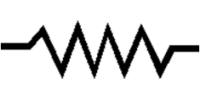
19.3 Resistance and resistivity
Resistance is measured in ohms (Ω).
1 Ω = 1 V A⁻¹
Since the term significant resistance refers to a small resistance,
it is common for a resistor to have kilo ohm (K Ω ) and mega
ohm (M Ω ) values.
1 k Ω = 1 kilo ohm = 10 ³ Ω
1 ΜΩ = 1 mega ohm = 10 ⁶ Ω
1 G Ω = 1 giga ohm = 10 ⁹ Ω

Slide 5
19.3 Resistance and resistivity
The greater the resistance of a component, the more difficult it is for charge to flow through it.
When the free electrons collide with the positive ions in the lattice, they give up some of their energy to them. This collisions generate heat that causes the temperature of the metal to increase.
We say that a current produces a heating effect.

Slide 6
19.3 Resistance and resistivity
1. The label on a small heater specifies its electric performance as 115 V, 4.50 A.
a. What is the resistance of the heating filament in this heater?
b. How much current will it draw when connected to the following:
(i) 120 V,
(ii) 220 V
(iii)60.0 V
2. Three resistors are available for testing a 9.00 V battery. Resistor A has has 5.00 kΩ of
resistance, resistor B has 5.00 Ω of resistance, and resistor C has 0.0500Ω of resistance.
a. How much current will each resistor draw?
b. Which resistor is more useful for testing if the battery is dead? Explain.
3. An electrical device of 37.2 Ω resistance performs best when the current is 3.62 A.
How much voltage should be applied?
4. An electronic device performs best with a 1.20 V battery , when the current is
between 3.50 mA and 4.20 mA. What is the range of possible resistances
for this electronic device?

Slide 7
19.3 Resistance and resistivity
(i) sketch and explain the I-V characteristics of a metallic conductor at constant temperature, a semiconductor diode and a filament lamp.

Slide 8
19.3 Resistance and resistivity
Voltage-Current Graph for a Metal Conductor
When metals are heated it causes the atoms in the metal to vibrate more. Imagine an electron in a current travelling through heated copper.
It's trying to flow through the metal but the atoms are vibrating more, so they are going to get in the way more, causing more collisions. More collisions gives more resistance.

Slide 9
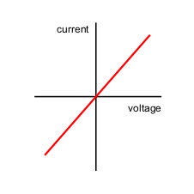
19.3 Resistance and resistivity
Voltage-Current Graph for a Metal Conductor

Slide 10
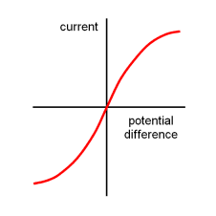
19.3 Resistance and resistivity
Voltage-Current Graph for a filament lamp.

Slide 11
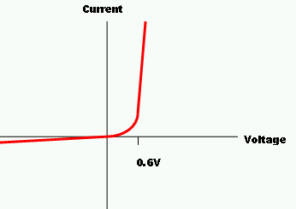
19.3 Resistance and resistivity
Voltage-Current Graph for a semiconductor diode.

Slide 12
19.3 Resistance and resistivity
(j) sketch the temperature characteristic of a
thermistor.

Slide 13
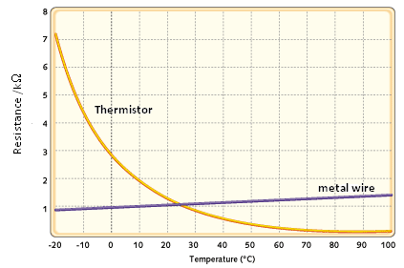
19.3 Resistance and resistivity
Resistance-temperature Graph of a thermistor.

Slide 14
19.3 Resistance and resistivity
(k) state Ohm’s law

Slide 15
19.3 Resistance and resistivity
The Ohm´s law state that:
“ If the temperature of a conductor kept constant,
it´s resistance is constant over a wide range of
applied potential differences. Therefore potential
difference is directly proportional to the current
through the conductor”.

Slide 16
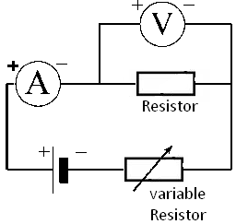
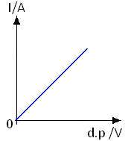
19.3 Resistance and resistivity
To study Ohm´s law we usually use the following circuit:

Slide 17
19.3 Resistance and resistivity
Ohm's law
Ohm's law states that:
The ratio of the current in a conductor to the potential difference (voltage difference) between its ends is a constant as long as the temperature stays constant.
This constant is called the RESISTANCE of the conductor. Resistance = Voltage (V)/Current(I) or R = V/I Voltage = Current x Resistance or V = IR Resistance is measured in units called Ohms ( Ω ).
The resistance of a piece of wire is 1 ohm if a current of 1 A flows through it when a voltage of 1 V is applied between its ends.

Slide 18
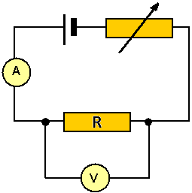
19.3 Resistance and resistivity
Using an ammeter and a voltmeter to measure resistance.
To measure the resistance of say a piece of wire or a resistor we must find the voltage (potential difference) between its two ends and the current flowing
through it. An ammeter is always connected
in series with the component and
a voltmeter is always connected
in parallel with the component.

Slide 19
19.3 Resistance and resistivity
(l) recall and solve problems using

Slide 20
19.3 Resistance and resistivity
Resistivity
The resistance of a material depends on:
(a) the temperature (b) the dimensions of the specimen (c) the material from which the specimen is made The property of the material that affects its resistance is called the resistivity
of the material and is given the symbol ρ. The resistivity of a material is the resistance between two opposite faces of a 1 m³ specimen of the material.
Resistivity (ρ) = R A/ L
The units for resistivity are Ωm. Example resistivities: Copper 1.69x10⁻⁸ Ωm Non-metals 10⁴ Ωm

Slide 22
19.3 Resistance and resistivity
Question 1:
What length of an alloy wire of resistivity
5.0 x 10⁻⁷ Ω m and diameter 0.50 mm is
required to make a standard 6.0 Ω resistor?

Slide 23
19. Current of electricity
Solution:
The resistance is given by the equation:
R = ρ x L /A ➔ L = R x A /ρ
( when: A = πd²/4)
L = (6.0) x (π [0.50 x10⁻³] ² /4) / 5.0 x 10⁻⁷
Then:
L = 2.4 m

Slide 24
19. Current of electricity
Question 2:
The table in the next slide is a selection of some of
the specifications to be found in a manufacturer´s
catalogue of wires for use in electrical circuits.
Carry out calculations necessary to complete the table.

Slide 25
19. Current of electricity
 | Material | Wire diameter /mm | Resistance per unit length / Ωm⁻¹ | Resistivity / Ωm
i) | Cooper |  | 0.55 | 1.7 x 10 ⁻ ⁸
ii) | Constantan | 0.30 |  | 47 x 10 ^{– 8}
iii) | Nichrome | 0.45 | 7.0

Slide 26
19. Current of electricity
 | Material | Wire diameter /mm | Resistance per unit length / Ωm⁻¹ | Resistivity / Ωm
i) | Cooper | 0.20 | 0.55 | 1.7 x 10 ⁻ ⁸
ii) | Constantan | 0.30 | 6.65 | 47 x 10 ^{– 8}
iii) | Nichrome | 0.45 | 7.0 | 1.1 x 10 ⁻ ⁶

