Slide 1
Atomic Physics

Slide 2
Core
(d) Half-life -use the term half-life in simple calculations which might involve information in tables or decay curves
(e) Safety precautions -describe how radioactive materials are handled, used and stored in a safe way

Slide 3
Half life
There are two definitions of half life:
The time it takes the number of radioactive nuclei in a sample to decrease by 50%.
The time it takes the count rate from a radioisotope to decrease by 50%.
You must learn both of these definitions!

Slide 4
Graphical representation of half life
Decay rate (counts/min)
What is the half life of the radioisotope represented by the following graph?
80
60
40
20
The time it takes the count rate to decrease from 80 per min to 40 per min is what?
2 mins
Double check, the time it takes the count rate to decrease from 40 per min to 20 per min is?
2 mins
2 4 6 8
Time (min)
The half life of the radioisotope is 2 mins.

Slide 5
Half life questions
What are the two definitions of half life?
If 1/64th of an original radioisotope is left after 1 hour, what is the half life of the sample?
A radioisotope has a half life of 12 minutes. What fraction of the radioisotope will be left after 2 hours?
The background radiation in a laboratory is 13 counts per minute. The count rate from a radioisotope is measured and it has a reading of 119 counts per minute. If the half life of the radioisotope is 10 minutes, what will be the reading 20 minutes later?

Slide 6
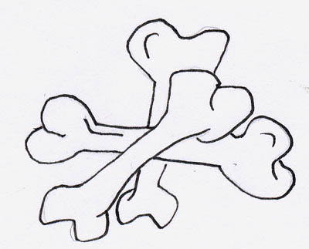
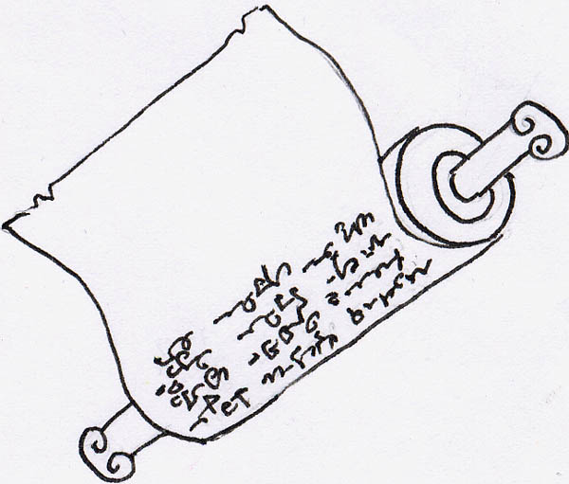
Carbon Dating
All living things take in a little radioactive carbon-14 in photosynthesis, as well as the normal carbon-12. When living things die, they stop taking in carbon-14 and so the carbon-14 present at death slowly decays to carbon-12 (half-life is 5 600 years).
The radioactivity due to the decay of carbon-14 can be used to date bones, wood, paper and cloth.

Slide 7
Example
A fresh bone gives a radioactive count of 170 counts per minute. Another ancient bone of the same mass gives a count rate of 50 counts per minute. The background count is 10 counts per minute.
How old is the bone?
click
Counts due to bones are 170 - 10 = 160 (fresh) and
50 - 10 =40 (ancient)
The count rate of the carbon-14 has fallen to one quarter of its original value, i.e. 160/2 = 80, 80/2=40.
This is two half lives,
So the bone is 5600 x 2 =11200 years old.

Slide 8
To do
P 258-9
Answer all questions

Slide 9
Core
(e) Safety precautions -describe how radioactive materials are handled, used and stored in a safe way

Slide 10
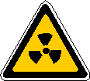
Safety first
There are several types of radiation. They differ in what effects they have and their nature.
All radioactive sources must be handled safely.
Do you know what the hazard symbol for radiation is?
As well as the normal laboratory safety instructions you follow are there any extra rules concerning radioactivity?

Slide 11
Springfield Nuclear Power Plant Safety Rules:
Any employee who fails to adhere to the rules below will be suspended:
Do not handle radioactive sources directly use tongs or a robotic arm.
Never point a radioactive source at a fellow worker or yourself.
When not in use store radioactive sources in lead-lined containers.
Always wear radiation protection suits.
Radiation badges should be worn to record exposure to radiation.
Mr. Burnz
Task:
Working in pairs write down the three safety rules from above that would be most relevant in your school saying why you chose them. Also say which safety rule you think is the most important and why.

Slide 12
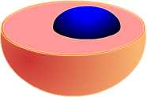
Ionising radiation
What happens if radiation is incident upon a living cell?
Radiation can ionise cells which causes cellular damage.
If the exposure is high, it can kill the cell.
If the exposure is lower it can cause cancer.
The higher the exposure, the higher the risk of cancer.
Alpha is the most ionising radiation, gamma is the least.
Ionising radiation can be used to kill cancer cells.

Slide 13
To do
Safety worksheet

Slide 14
Ionisation questions
What is ionisation?
How is a neutral atom positively ionised?
How is a neutral atom negatively ionised?
What two effects on living cells can ionisation have?
Which type of radiation is the most ionising?
Which type of radiation is the least ionising?
When a neutral atom loses or gains electrons and hence charge.
By losing electrons.
By gaining electrons.
Kill cells or cause cancer.
Alpha radiation.
Gamma radiation.

Slide 15
Which type of radiation is…..
The most penetrating?
The least penetrating?
Least dangerous outside the body?
Most dangerous inside the body?
High energy electrons?
Has a negative charge?
Is weakly ionising?
Has zero charge and zero mass?
Only reduced in intensity by lead and concrete?
Gamma
Alpha
Alpha
Alpha
Beta
Beta
Beta
Gamma
Gamma

