Slide 1
CT scanning
(f) Candidates should be able to show an understanding of the principles of CT scanning.
(g) Candidates should be able to show an understanding of how the image of an 8-voxel cube can be developed using CT scanning.

Slide 2
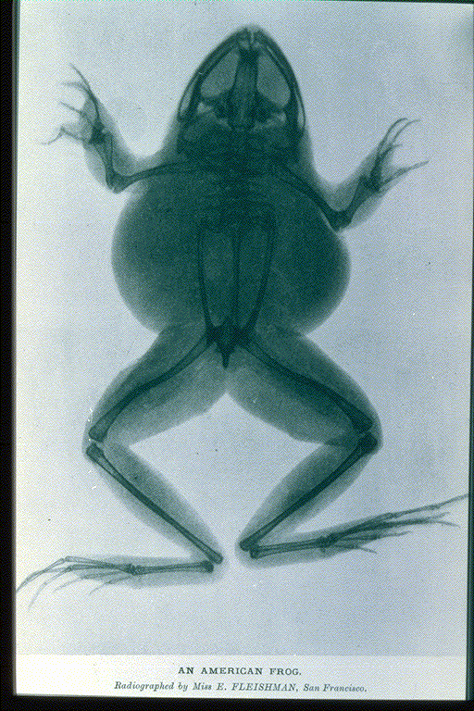
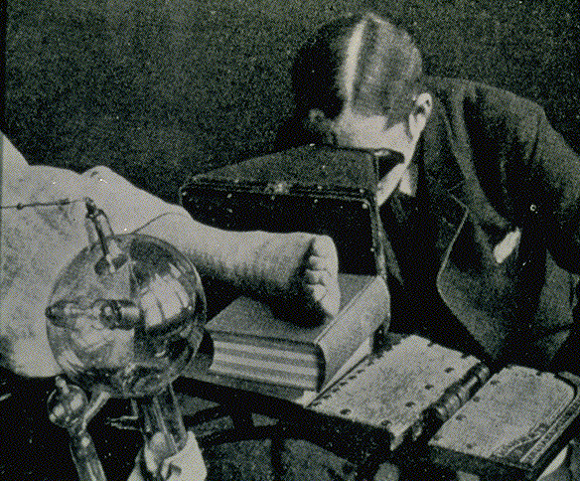
X-ray: The beginning
X-Rays discovered in 1895 by Wilhelm Conrad Roentgen

Slide 3
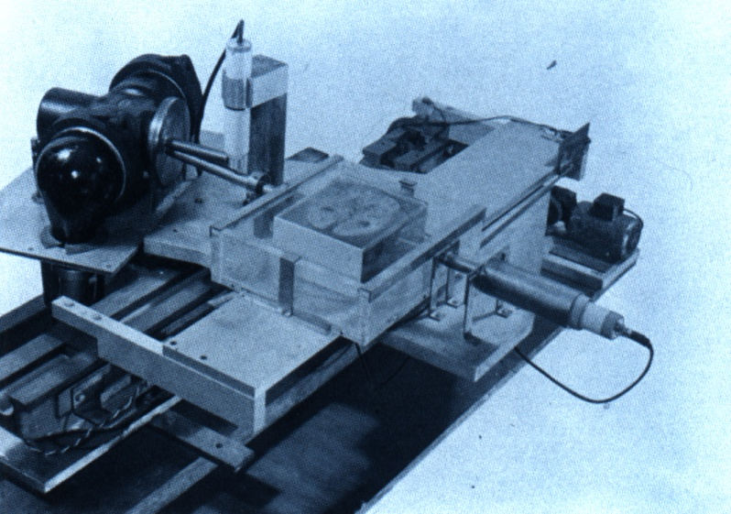
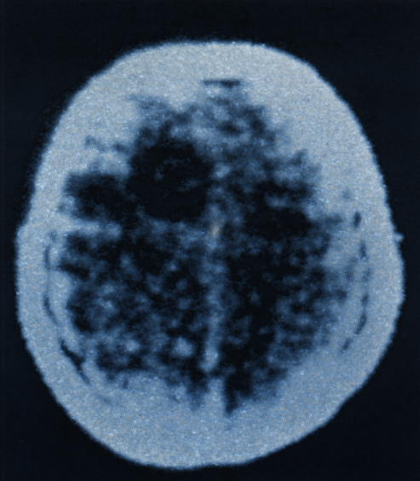
CT: The beginning
CT founded in 1970 by Sir Godfrey Hounsfield
Engineer with EMI, LTD.
first applications were in neuroradiology

Slide 4
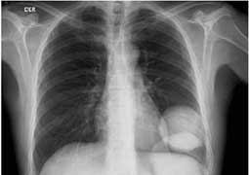
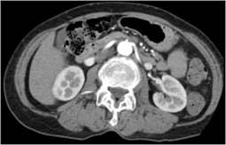
X-rays vs CT
Both CT and conventional x-rays take pictures of internal body structures. I
n conventional x-rays, the structures overlap. For example, the ribs overlay the lung and heart. In an x-ray, structures of medical concern are often obscured by other organs or bones, making diagnosis difficult.

Slide 5
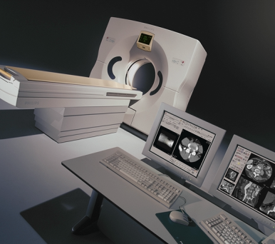
CT Scanner
X-Ray modality used to the body in cross section
Used to determine
extent of trauma
location and type of tumors
status of blood vessels
pre surgical planning

Slide 6
CT System

Slide 7
Basic CT scanner components
Gantry
X-Ray Tube
Detector
Control Console

Slide 8
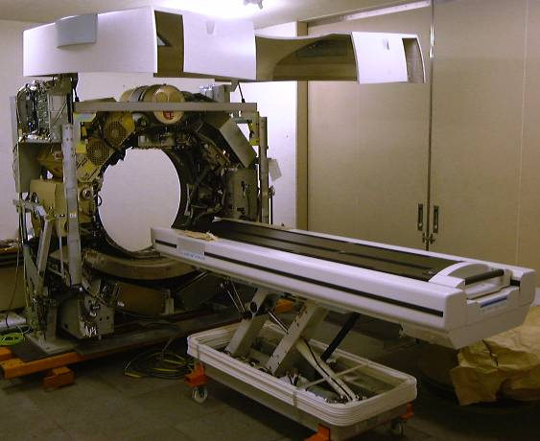
Gantry
CT X-ray tube
High voltage generator
Detector array
Data acquistion system
Slip ring

Slide 9
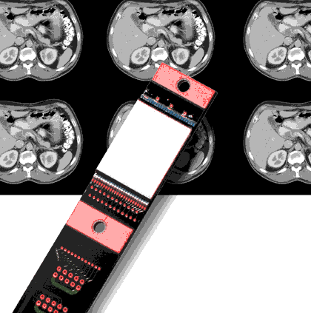
Detector Elements
Capture energy that has not been attenuated by the patient

Slide 10
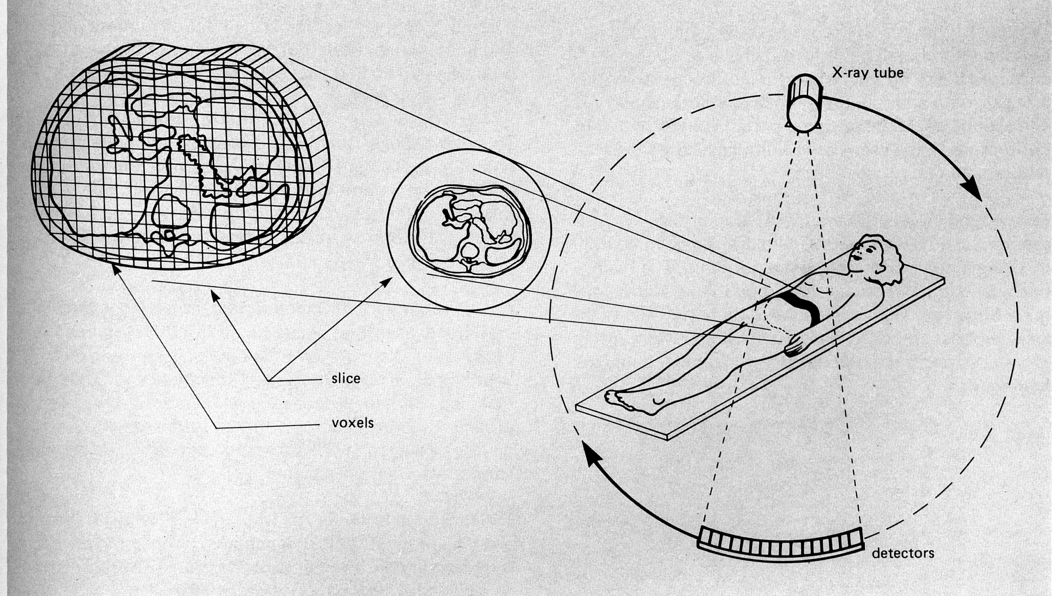
CT
CT - Computed Tomography
CAT Scan - Computerized Axial Tomography

Slide 11
Scanning methods
Surview
AP,Lat
Surview, Scanogram , Topogram….
Conventional CT
Axial
Start/stop
Volumetric CT
Helical or spiral CT
Continuous acquisition

Slide 12
Building up an image
The section (or slice) through the body is divided up into a series of small units called voxels.
The image of each voxel would have a particular intensity, known as a pixel.
The pixels are built up from measurements of X-ray intensity made along a series of different directions around the section of the body.

Slide 13
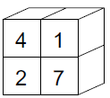
A 4 voxel section
This section is made up of 4 voxels.
Each voxel in the section has a particular intensity (the lower the intensity the more X-rays are absorbed.
(We do not know this before the scan)

Slide 14
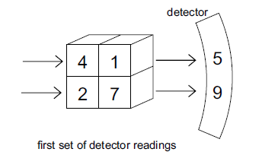
Building up an image
X-rays are directed at the sample from one direction.
And the measurement of intensity taken

Slide 15
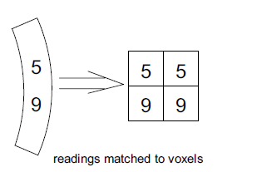
Total intensity direction 1 recorded
It is not known how much each voxel contributes to the intensity.

Slide 16
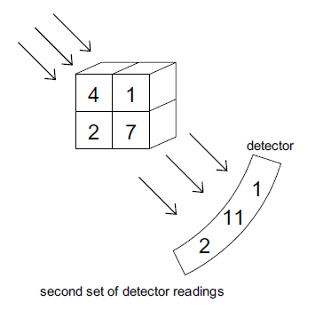
Repeat from 2nd direction

Slide 17
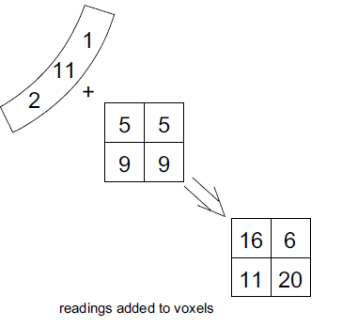
And add to values

Slide 18
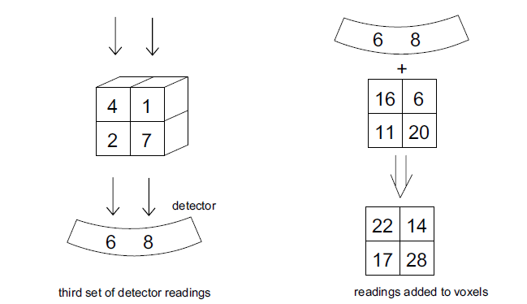
Repeat

Slide 19
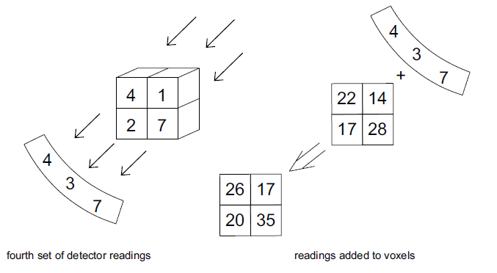
And one more time

Slide 20
Now to build up our voxels
Deduct the ‘background’ intensity. The sum of the intensities in each case (14 here)

Slide 21
Divide by the number of extra views.
And there is your image
Now multiply by a few billion times to get a CT image!

Slide 22
Advantages of CT scans
Better detail compared with ultrasonography.
Relatively quick compared with MRI scanning.
Most systems can be scanned, eg brain to leg.
painless non invasive procedure with good sensitivity to detect pathology of the head
superior to an MRI when evaluating skull fractures
Can provide detailed images of the brain nervous tissue
Much cheaper than an MRI an equally as fast
The motion artifacts are less of a problem with a CT scan compared to an MRI.
Can be performed in patients with implanted medical devices.

