Slide 1
Damping
State what is meant by damping.
Describe examples of damped oscillations.

Slide 2
Need to know
- It is sufficient for students to know that damping involves a force that is always in the opposite direction to the direction of motion of the oscillating particle and that the force is a dissipative force.
Reference should be made to the degree of damping and the importance of critical damping. A detailed account of degrees of damping is not required.

Slide 3
What is damping?
A damped oscillator is subject to a damping force which is linearly dependent upon the velocity,
The oscillation will have exponential decay terms which depend upon a damping coefficient.
If a damping force is related to velocity F=-cv (note the negative sign)
The damping force is proportional to c, but in the opposite direction to the motion

Slide 4
Investigating damping
design your own arrangement for investigating damped SHM.
You can investigate the pattern of decrease of amplitude, and whether the frequency is affected by damping.
Plot amplitude versus number of swings or against time.

Slide 5
Results
The decay of the amplitude is exponential and careful measurement of the period may show that it is slightly less than the ‘undamped’ value.

Slide 6
Exponential decay
Exponential decay of the amplitude A implies that:
Rate of decay of maximum amplitude A ∝ present value of A.
Large amplitude implies high maximum velocity, which implies greater drag.
PE_{MAX} ∝ A², so the total energy of an oscillator ∝ A²
When the amplitude has decayed to 1/2 its original value, the energy has been reduced to 1/4 of the original input and so on.

Slide 7
Types of damping
Critical damping provides the quickest approach to zero amplitude for a damped oscillator
With less damping (underdamping) it reaches the zero position more quickly, but oscillates around it.
With more damping (overdamping), the approach to zero is slower.
Critical damping occurs when the damping coefficient is equal to the undamped resonant frequency of the oscillator (next lesson)
Overdamping of a damped oscillator will cause it to approach zero amplitude more slowly than for the case of critical damping.
When a damped oscillator is underdamped, it approaches zero faster than in the case of critical damping, but oscillates about that zero point.
http://hyperphysics.phy-astr.gsu.edu/hbase/oscda2.html

Slide 8
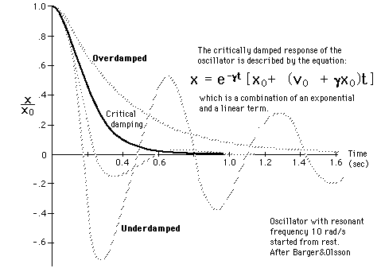

Slide 9
Using damping
For some oscillators (e.g. clocks) we want minimum damping;
for others (e.g. a vehicle shock absorbing system) we want them to return to equilibrium as fast as possible.
The latter requires a unique value of the damping (‘critical damping’) so that the system returns to equilibrium without overshooting; i.e. it gets to equilibrium in the minimum time without oscillating at all.
Overdamping prevents over-shooting and thus any oscillations,
By making the damping large enough the system can take as long as you want to regain its starting equilibrium position.

Slide 10
References
Text book p 115
http://mathworld.wolfram.com/DampedSimpleHarmonicMotionCriticalDamping.html - for maths heads
http://hyperphysics.phy-astr.gsu.edu/hbase/oscda2.html

