Slide 1
ENERGY

Slide 2
Core
Demonstrate an understanding that an object may have energy due to its motion or its position, and that energy may be transferred and stored
Give examples of energy in different forms, including kinetic, gravitational, chemical, strain, nuclear, internal, electrical, light and sound
Give examples of the conversion of energy from one form to another, and of its transfer from one place to another
Apply the principle of energy conservation to simple examples

Slide 3
Supplement
Recall and use the expressions k.e. = ½ mv ² and p.e. = mgh

Slide 4
ENERGY
Things have energy if they can be used to do work.
The SI unit of Energy is: joule (J)
1 kilojoule = 1 kJ = 1000 J = 10³ J
1 megajoule = 1 MJ = 1000000 = 10⁶ J

Slide 5
What is energy?
Energy lets you do things.
Another name for energy is ____
work
Joules
The units of energy are ______.
There are many different types of energy you need to know about.
How many joules in a kilojoule? _______
1 000 J

Slide 6
GREENSICK
Gravitational
Radiation (light)
Elastic
Electrical
Nuclear
Sound
Internal (Thermal)
Chemical
Kinetic

Slide 7
Nuclear energy
This is the energy stored in the nuclei of atoms.
When nuclei are joined together or split apart, large amounts of energy are released.
Nuclear fusion
Nuclear fission
Nuclei being split
Nuclei joining together

Slide 8
Nuclear fusion
When atomic nuclei join together (fuse) it releases massive amounts of energy.
Where does nuclear fusion happen in nature?
In the Sun and other stars.

Slide 9
Nuclear fission
When atomic nuclei are split apart it releases massive amounts of energy.
Where does nuclear fission occur?
Nuclear power stations
Atomic weapons

Slide 10
Nuclear energy summary
uclei
Nuclear energy is the energy stored in the n____ of atoms.
When atomic nuclei join together it is known as nuclear f_____. When atomic nuclei are split apart it is known as nuclear f_____.
Nuclear fission powers nuclear p____ s_____ and atomic weapons.
Nuclear fusion powers the Sun and other s____.
usion
ission
ower tations
tars

Slide 11
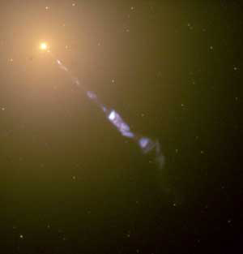
Light energy
Light is a type of electromagnetic radiation.
Light travels in straight lines.
Light travels in transverse waves.
Light transmits ENERGY.
Our Sun (a star) is a light source, just like a filament lamp or a firefly.
Which colour of light has the most energy, red or violet?
How do we see the planets?
violet
By reflected light.

Slide 12
Sound energy
ibrations
Sounds are caused by v_______.
Sound travels in l_________ waves.
Sound transmits e____.
The l_____ the sound, the more energy it transmits.
The q_____ the sound, the less energy.
ongitudinal
nergy
ouder
uieter

Slide 13
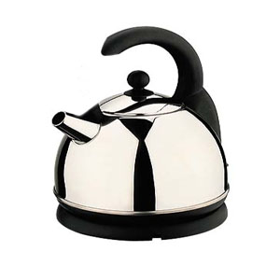
Heat energy
The hotter an object is, the more heat or thermal energy it has.
Electrical devices use the fact that as electrons flow along a conductor, friction between the electrons and the conductor’s atoms occurs. Whenever you get friction you get heat, so the movement of electricity generates heat energy.
Some devices that are designed to
produce heat energy are:
________
________
___________
Kettles
Toasters
Electric fires

Slide 14
Electrical energy
This is the energy electrons have as they flow around a circuit.
Electricity is so useful because it is such a convenient way to transfer energy to a desired location or to a desired device.
What happens when the switch is closed?
Electricity flows and the bulb lights.

Slide 15
Elastic energy
If you squash or c_______ an object or material, when you let go some materials have the p_______ to return to their original shape. We call the energy stored in a squashed or compressed material e_____ energy.
The same is true for materials that are s_______ (put under t_____) they too have the potential to return to their original shape. They too store elastic energy.
ompress
A Jack-in-the-box stores elastic energy
otential
Boo!!!!
lastic
tretched
ension
Press

Slide 16
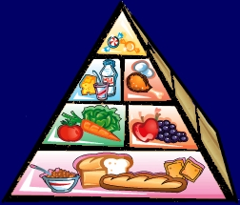
Chemical energy
When chemical bonds are broken they can release
energy. The energy stored in these chemical bonds
is referred to as chemical energy.
The three sources of chemical energy you need to know
about are:
___________
___________
___________
Batteries
Fuels
Food

Slide 17
Gravitational energy
Any object in a gravitational field has gravitational potential energy due to its position in that field.
Moon
The _____ has gravitational potential energy due to the gravitational field of the Earth.
The ____ has gravitational potential energy due to the gravitational field of the Sun.
Earth

Slide 18
Changes in gravitational potential energy
For an object in Earth’s gravitational field:
If an object falls will it gain or lose gravitational potential energy?
If an object moves up will it gain or lose gravitational potential energy?

Slide 19
GPE=Wh
We can calculate the change in gravitational potential energy (GPE) for a moving object using the formula below:
Change in GPE = Weight x Change in height
GPE=Wh
GPE measured in Joules (J)
Weight measured in Newtons (N)
Height measured in Metres (m)

Slide 20
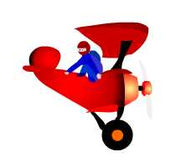
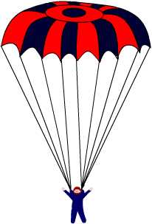
A parachutist
A parachutist of weight 600N jumps from a plane, 2000m above the ground.
How much gravitational potential energy will she have lost when she reaches the ground?
Change in GPE = Weight x change in height
= W x h
= 600N x 2 000m
= 1 200 000 J

Slide 21
Kinetic energy
This is the energy possessed by an object due to its movement.
What factors will increase the amount of kinetic energy a moving object has?
The velocity of the object
The shape of the object
The mass of the object
The height of the object
✓
x
✓
x

Slide 22
Mass and speed
If you increase the mass of a moving object you increase the kinetic energy.
If you double the mass, you double the kinetic energy.
If you increase the speed of a moving object you increase the kinetic energy.
BUT… If you double the speed, you quadruple the kinetic energy.
This is why even if you are slightly above the speed limit, you increase the kinetic energy of a moving car a lot, this means it is harder to stop the car and there is more chance of an accident.

Slide 23
KE=½m(v)²
We can calculate the kinetic energy (KE) for a moving object using the formula :
Kinetic Energy = ½x mass x(velocity)²
KE=½mv²
KE measured in Joules (J)
Mass measured in Kilograms (Kg)
Velocity measured in Metres per second (ms⁻¹)

Slide 24
Rearranging the kinetic energy formula
You may be asked to rearrange the kinetic energy formula so you can calculate the mass of a moving object or the velocity of a moving object.
If you do not think you can rearrange the formula in the examination, learn the rearranged formulae.
Do you know what the two formula would be for mass and velocity?
Mass = 2KE
(v)²
Velocity = 2KE
m

Slide 25
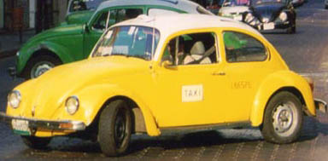
Kinetic energy calculation
A car has a mass of 400kg and a velocity of 10 ms⁻¹, what is the kinetic energy of the car?
Kinetic energy = ½ mass(velocity)²
= ½ x 400 x(10)²
= 20 000 J

Slide 26
What type of energy is stored in a coiled spring?
Sound
Kinetic
Elastic
Gravitational
✓

Slide 27
What type of energy is stored in potatoes?
Sound
Gravitational
Chemical
Elastic
✓

Slide 28
What is the change in gravitational potential energy of a weight of 60N that moves through a distance of 6m?
10J
360J
66J
54J
✓

Slide 29
What is the kinetic energy of a ball of mass 6kg and velocity 5ms⁻¹?
✓
75J
30J
1.2J
150J

Slide 30
What type of energy is stored in coal, oil and natural gas?
Light
Heat
Sound
Chemical
✓

Slide 31
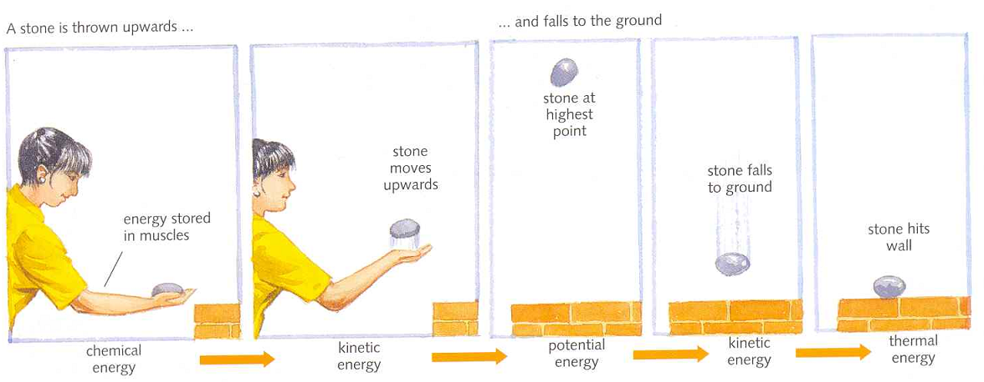
ENERGY
Energy transformation (p.80)
When energy changes from one form to another the
energy is transformed.

Slide 32
ENERGY
3. Conservation of energy. (p.80)
During each transformation, the total amount of energy stays the same.
The law of conservation of energy:
“Energy cannot be made or destroyed, but it can change from one form to another.”

Slide 33
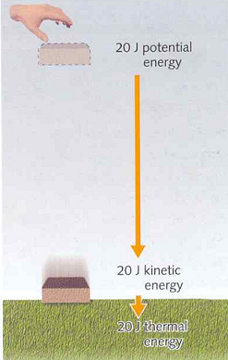

Slide 34
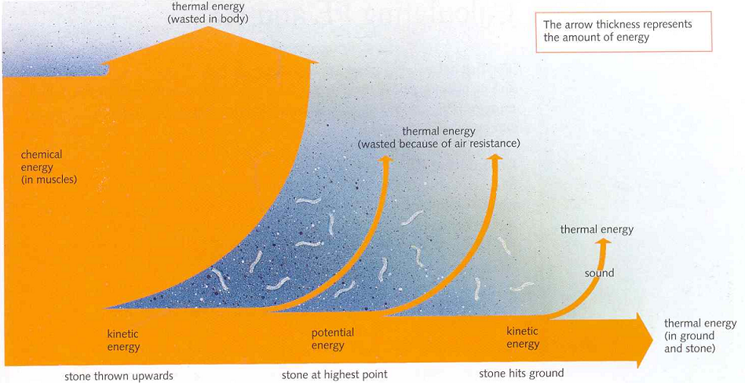
ENERGY

Slide 35
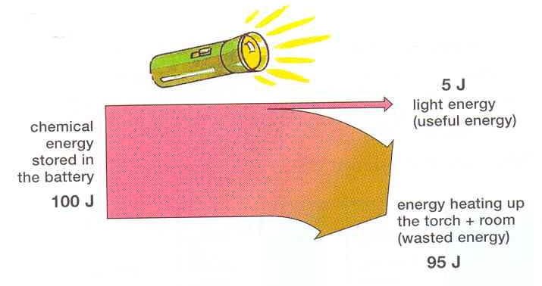
ENERGY TRANSFER

Slide 36
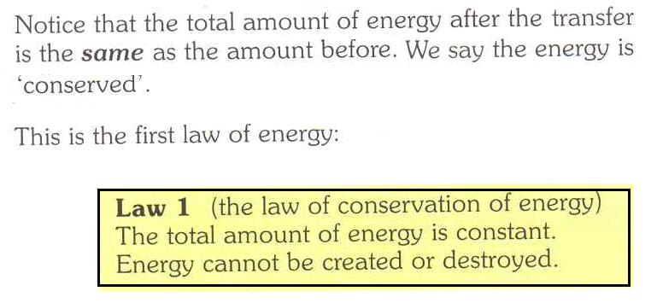
ENERGY TRANSFER

Slide 37
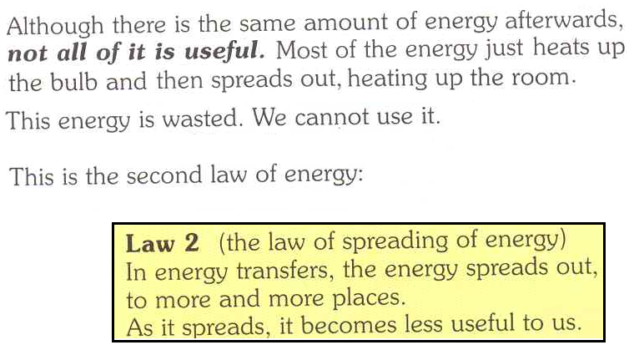
ENERGY TRANSFER

Slide 38
ENERGY
4. Wasting energy. (p.80)
The non useful energy is wasted energy.
Waste energy is always less than Total amount of energy.
Total amount = energy waste + useful energy
of energy

