Slide 1
Teacher Instructions
Watch the opening two minutes of http://www.youtube.com/watch?v=MGixcQ4DZTM to set the scene.
Run through slides 2-9. Hand out slides 10-16 to each group.
Show slide 17 when peer marking the posters or whilst your students are preparing their poster.
Get pupils to hold up a card with a letter to show their answers to the plenary questions.

Slide 2
Objective: To calculate pressure and apply to a real life situation.

Slide 3
Outcomes
All Should:
Recall the equation for calculating pressure (level 4)
Most should:
Use the equation to calculate pressure (level (level 5)
Some should:
Provide scientific evidence to back up a decision made (level 6)

Slide 4
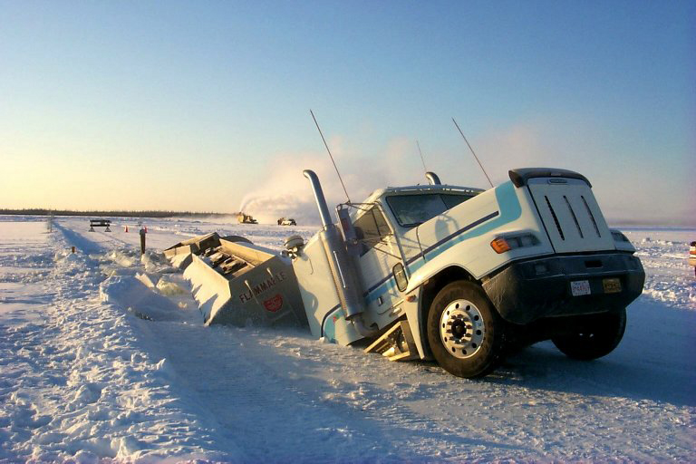
A dangerous Job

Slide 5
But Science and Maths help to make it possible!

Slide 6
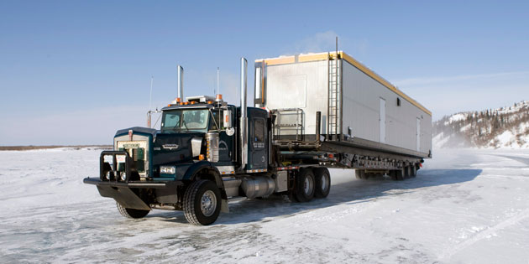
How would you work out how much pressure is being put on the ice?

Slide 7
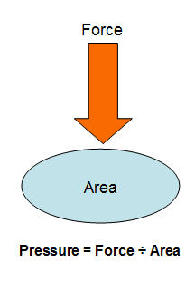

Slide 8
Its weight (the force) is 400000 N.
The trucks tyres have an area 1000cm2 in contact with the ice
Pressure = Force / Area
400000 / 1000 = 400 N/cm2
The ice road can withstand pressure of up to 500N/cm2.

Slide 9
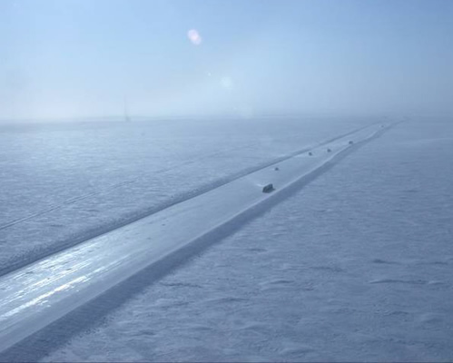
The ice road can withstand pressure of up to 500N/cm².
So the truck will not break ice!

Slide 10
Group task
You are the latest recruit for the ice road truckers.
You must select a vehicle that will drive on the ice roads.
It must not fall through the ice!

Slide 11
How to achieve in this task
Work out the amount of pressure that each truck puts on the ice.
Select which truck will be able to do the job.
Present your findings in the form of a poster.

Slide 12
The ice road can withstand pressure of up to 500N/cm².
Which trucks will break the ice? Which truck will be suitable?

Slide 13
Truck Name: Do not say Snow to me! Weight: 500,000 N Area of Tyres: 800cm²

Slide 14
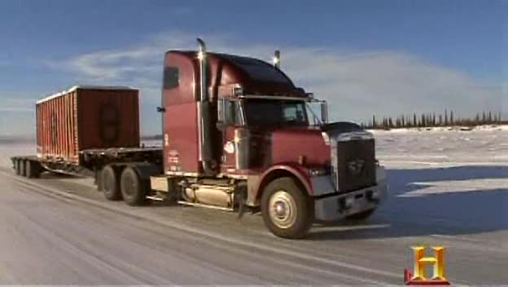
Truck Name: Ice Ice Baby Weight: 400,000 N Area of Tyres: 500cm²

Slide 15
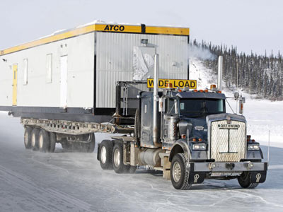
Truck Name: It’s Snow Joke Weight: 600,000 N Area of Tyres: 1000cm²

Slide 16
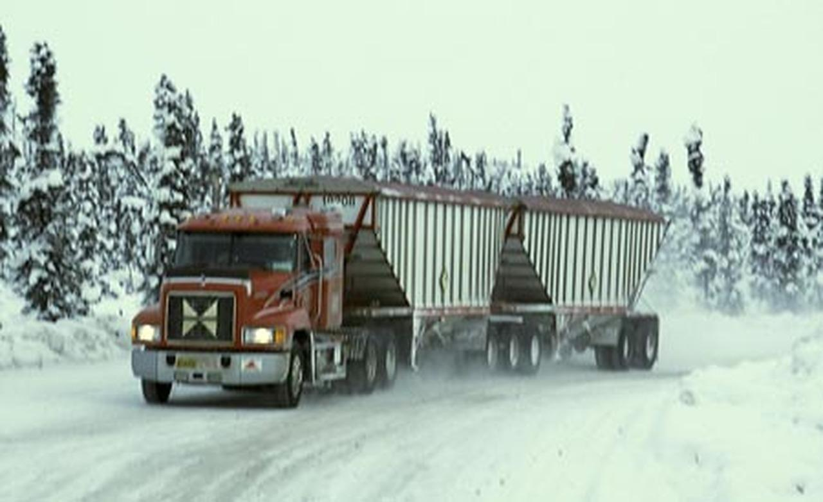
Truck Name: Ice to Meet You Weight: 400,000 N Area of Tyres: 900cm²

Slide 17
Peer Marking
Swap posters with another group. Award it a level based on the outcomes of the lesson.
Recall the equation for calculating pressure (level 4)
Use the equation to calculate pressure (level 5)
Provide scientific evidence to back up a decision made (level 6)

Slide 18
Calculate the pressure you exert on the ground using squared paper and the scales at the front of the class.

Slide 19
Plenary: Hold up the correct card
What is the equation for pressure?
(a) Pressure = force/mass
(b) Pressure = area/force
(c) Pressure = force/area
(d) Pressure = mass/area

Slide 20
Plenary: Hold up the correct card
An elephants weight is 12000N and the area of its feet is 400cm² .How much pressure does the elephant exert on the ground?
(a) 1000N/cm²
(b) 8000N/cm²
(c) 12400 N/cm²
(d) 30N/cm²

