Slide 2
Solids, liquids and gasses
State the properties of solids, liquids and gases.
Describe the molecular structure of solids, liquids and gases

Slide 3
Solids, liquids and gasses
Relate the properties of solids, liquids and gases to the forces and distances between molecules and to the motion of the molecules
Show an appreciation that massive particles may be moved by light, fast-moving molecules

Slide 4
The Kinetic theory
http://preparatorychemistry.com/Bishop_KMT_frames.htm

Slide 5
Interpret the temperature of a gas in terms of the motion of its molecules

Slide 6
Demo : Diffusion of KMnO₄
Observations: KMnO₄ (potassium permanganate) diffuses faster in hot water.
Explanation: KMnO₄ dissolves in water. As the KMnO₄ dissolves, it collides with H₂O molecules and spreads out. Because molecules in hot water are moving faster, the solid dissolves faster and diffuses faster.
Cold water
Hot water

Slide 7
Describe qualitatively the pressure of a gas in terms of the motion of its molecules

Slide 8
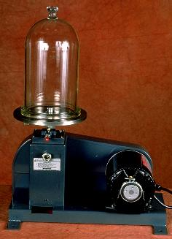
Demo : Kill da wabbit
Question: what will happen when the air pressure surrounding a balloon is decreased? Why?
Explanation: A balloon normally stays the same size because the pressure inside the balloon is equal to the pressure outside the balloon (rate of collisions with the wall of the balloon is equal). Reducing the pressure on the outside eliminates opposing collisions, allowing the balloon to expand.
For more lessons, visit www.chalkbored.com

Slide 9
Boyles Law
Relate the change in volume of a gas to change in pressure applied to the gas at constant temperature
Supplement
Recall and use the equation pV = constant at constant temperature
Now read and try the questions on p70 -71.

Slide 10
Describe qualitatively the effect of a change of temperature on the pressure of a gas at constant volume

Slide 11
Exploding Can

Slide 12
http://www.youtube.com/watch?v=N1pIYI5JQLE
http://www.youtube.com/watch?v=NsdCzujHqAk&feature=related

Slide 13
Show an understanding of the random motion of particles in a suspension as evidence for the kinetic molecular model of matter
Describe this motion (sometimes known as Brownian motion) in terms of random molecular bombardment

Slide 14
Brownian motion
Watch the smoke cell demonstration.
Draw the apparatus (Scientific not artistic).
Describe the motion of the particles.

Slide 15
To do
P98 – 99
Answer all questions

