Slide 1
Electromagnetic induction

Slide 2
From the syllabus
Electromagnetic effects
(a) Electromagnetic induction
Describe an experiment which shows that a changing magnetic field can induce an e.m.f. in a circuit
(b) a.c. generator -describe a rotating-coil generator and the use of slip rings
sketch a graph of voltage output against time for a simple a.c. generator

Slide 3
Extended
-state the factors affecting the magnitude of an induced e.m.f.
-show understanding that the direction of an induced e.m.f. opposes the change causing it

Slide 4
Chapter 36 : Electromagnetic Induction 1
Basics You should learn:
How a current can be induced
Fleming’s Right-Hand Rule
That the magnetic field must be changing for a current to be induced
Lenz’s law.

Slide 5
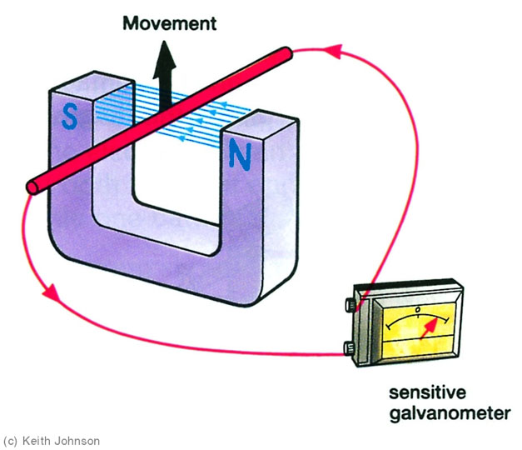
Induced current

Slide 6
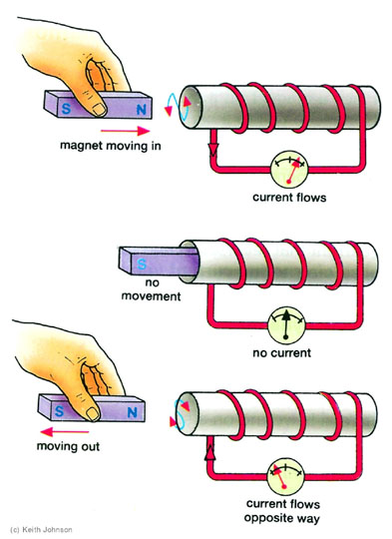
Induced current in a coil

Slide 7
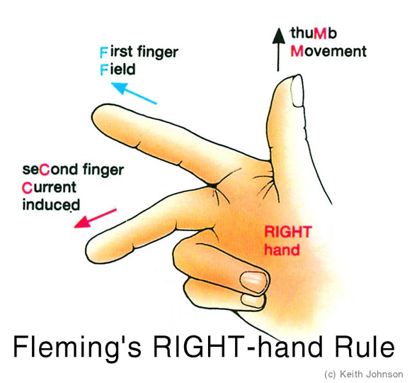
Fleming’s right hand rule

Slide 8
Notes
Read p302-304 then close your book
Define ‘electromagnetic induction’
What is Faraday’s law?
Write down 3 ways to induce a larger current
What is represented by each finger in Fleming’s right hand rule?
Write down Lenz’s law
Name 3 devices that use the principle of electromagnetic induction

Slide 9
Practice questions
P311 Questions 3&6

Slide 10
Chapter 36 : Electromagnetic Induction 1
Explain how this microphone uses electromagnetic induction.
2. We can work out the direction of the induced current using F_______ ____-hand Rule.

Slide 11
Answers
Electromagnetic Induction 1
Explain how this microphone uses electromagnetic induction.
Sound waves cause the diaphragm to vibrate… → diaphragm causes a coil to move in a strong magnetic field from a permanent magnet, → currents are induced in the coil, → currents flow along microphone cable to amplifier.
2. We can work out the direction of the induced current using F_______ ____-hand rule.
Fleming’s Right-hand Rule.

Slide 12
Chapter 36 : Electromagnetic Induction 2 Generators and Dynamos
You should learn:
How a simple a.c. generator works, and the names of the parts
Peak Voltage and Effective Voltage (RMS) for alternating current
How a simple d.c. dynamo works, the parts, and the output waveform
Induction is used in car speedometers.

Slide 13
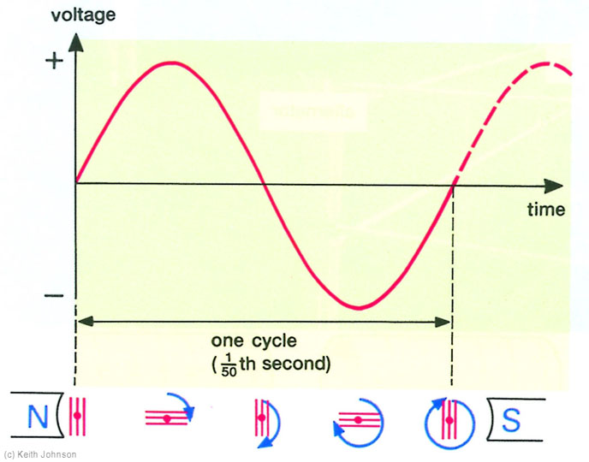
Output of an a.c. generator

Slide 14
Notes
Read p304-7 then close your books
What is alternating current?
What is the relationship between effective value and peak value – use a diagram?
List four ways to increase the emf of a generator
Draw the voltage output for a d.c. dynamo.

Slide 15
Questions
P310 Question 4,5&1

