Slide 1
Electromagnetic Radiation
Notes:
http://www.jessb.org

Slide 2
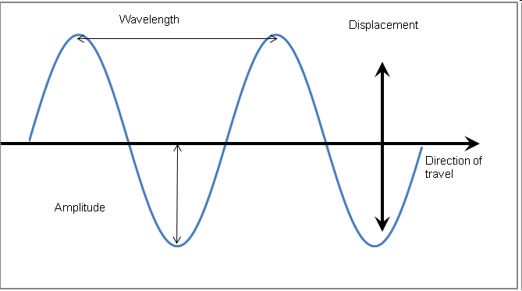
Waves… a review
Most waves are either longitudinal or transverse.
Sound waves are longitudinal.
But all electromagnetic waves are transverse…

Slide 3
?
?
Notes:
Prompt students to guess what the teal box, then the blue box, is hiding. (Wavelength, Amplitude)

Slide 4
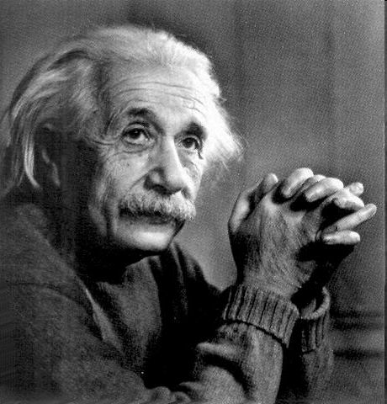
Electromagnetic waves
Produced by the movement of electrically charged particles
Can travel in a “vacuum” (they do NOT need a medium
Travel at the speed of
light
Also known as EM waves

Slide 5
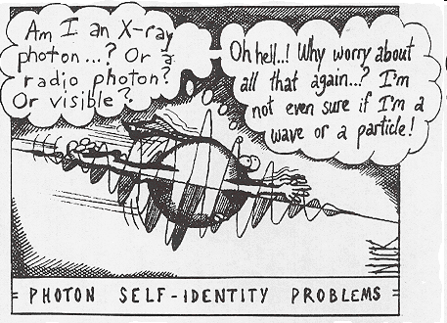
Wave-particle Duality
Light can behave like a wave or like a particle
A “particle” of light is called a photon

Slide 6
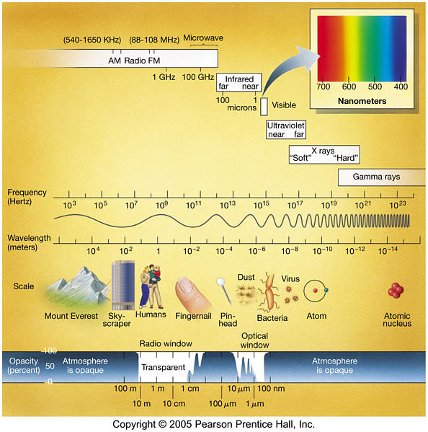
Notes:
Clicking the little rainbow box at the top of each slide will bring you back to this one

Slide 7
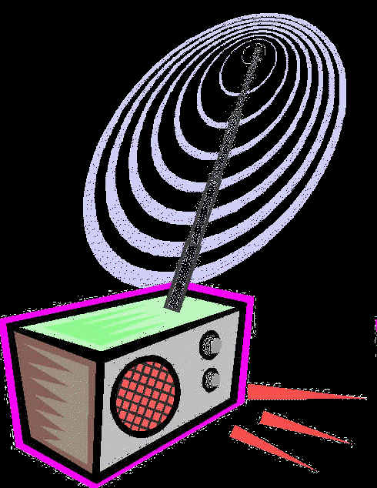
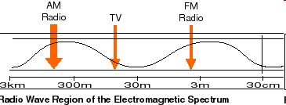
Radio waves
Longest wavelength EM waves
Uses:
  TV broadcasting
  AM and FM broadcast radio
  Avalanche beacons
  Heart rate monitors
  Cell phone communication
Notes:
Click the little rainbow box in the top right corner to return to the overview EM spectrum diagram

Slide 8
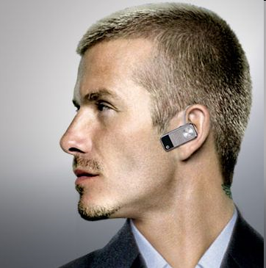
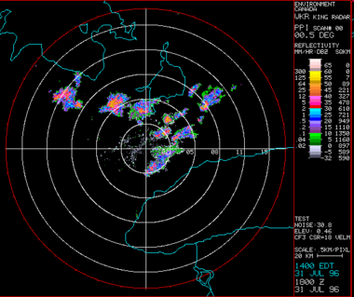
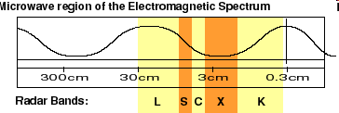
Microwaves
Wavelengths from 1 mm- 1 m
Uses:
  Microwave ovens
  Bluetooth headsets
  Broadband Wireless Internet
  Radar
  GPS
Notes:
Click the little rainbow box in the top right corner to return to the overview EM spectrum diagram

Slide 9
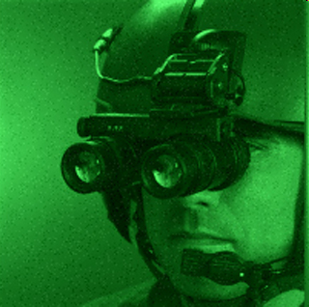
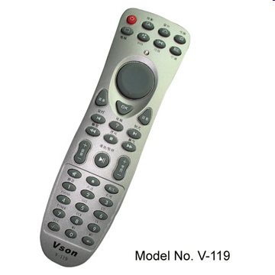
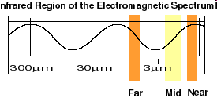
Infrared Radiation
Wavelengths in between microwaves and visible light
Uses:
  Night vision goggles
  Remote controls
  Heat-seeking missiles
Notes:
Click the little rainbow box in the top right corner to return to the overview EM spectrum diagram

Slide 10
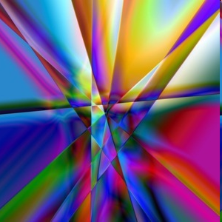
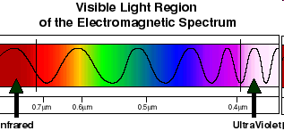
Visible light
Only type of EM wave able to be detected by the human eye
Violet is the highest frequency light
Red light is the lowest frequency light
Notes:
Click the little rainbow box in the top right corner to return to the overview EM spectrum diagram

Slide 11
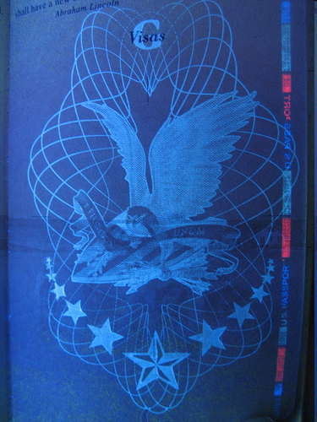
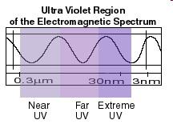
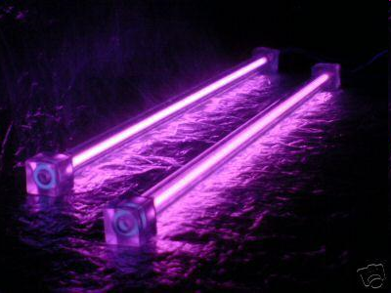
Ultraviolet
Shorter wavelengths than visible light
Uses:
  Black lights
  Sterilizing medical equipment
  Water disinfection
  Security images on money
Notes:
There is one more UV slide…

Slide 12
Ultraviolet (cont.)
 | UVA | UVB and UVC
Energy | Highest of UV waves | Lower than UVA
Health risks | Extremely low risk for DNA damage Can destroy Vitamin A in skin | Can cause DNA damage, leading to skin cancer Responsible for sunburn
Notes:
Table will fill in from left to right, top to bottom as you advance through. Click the little rainbow box in the top right corner to return to the overview EM spectrum diagram

Slide 13
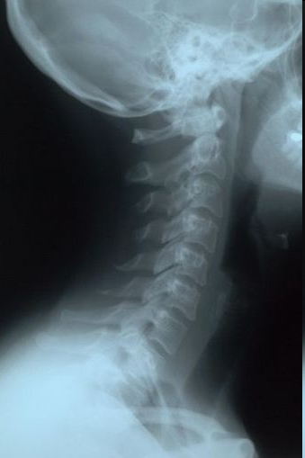
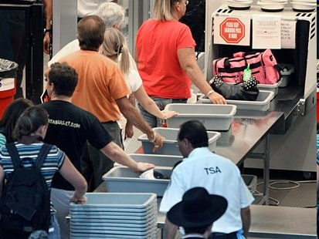
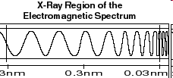
X-rays
Tiny wavelength, high
energy waves
Uses:
  Medical imaging
  Airport security
  Inspecting industrial welds
Notes:
Click the little rainbow box in the top right corner to return to the overview EM spectrum diagram

Slide 14
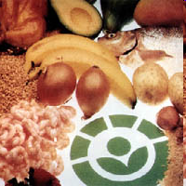
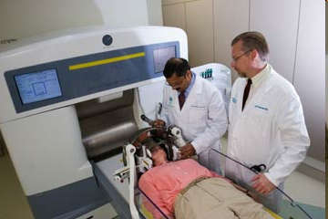
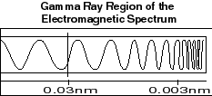
Gamma Rays
Smallest wavelengths, highest energy EM waves
Uses
  Food irradiation
  Cancer treatment
  Treating wood flooring
Notes:
Click the little rainbow box in the top right corner to return to the overview EM spectrum diagram

Slide 15
Image credits
http://www.antonine-education.co.uk/New_items/MUS/images/Making6.gif
http://www.geocities.com/researchtriangle/campus/6791/einstein12.jpg
http://abyss.uoregon.edu/~js/glossary/wave_particle.html
http://www.astro.princeton.edu/~gk/A402/electromagnetic_spectrum.jpg
http://science.hq.nasa.gov/kids/imagers/ems/radio.html
http://www.nentjes.info/Palace/radio-6.gif
http://www.mobilewhack.com/motorola-h12-bluetooth-headset.jpg
http://www.stuffintheair.com/radar-real-time-weather.html
http://www.imaging1.com/gallery/images/AV%20Night%20vision%20goggles.jpg
http://www.global-b2b-network.com/direct/dbimage/50329753/Study_Remote_Control.jpg
http://www.georgiaprismaward.com/The_Prism_Story_files/PRISM%20brand%20imagemed.jpg
http://science.hq.nasa.gov/kids/imagers/ems/uv.html

Slide 16
Image Credits
http://farm3.static.flickr.com/2385/2381723771_12548f4bd1.jpg?v=1217429879
http://intamod.com.au/images/uv2.JPG
http://science.hq.nasa.gov/kids/imagers/ems/xrays.html
http://www.sciencelearn.org.nz/var/sciencelearn/storage/images/contexts/see_through_body/sci_media/neck_x_ray/17945-5-eng-NZ/neck_x_ray_full_size_portrait.jpg
http://www.epinion.eu/wordpress/wp-content/uploads/2008/05/airport-security1.jpg
http://science.hq.nasa.gov/kids/imagers/ems/gamma.html
http://www.aboutnuclear.org/print.cgi?fC=Food
http://www.roswellpark.org/files/1_2_1/brain_spinal/gamma%20knife%204c.jpg

