Slide 1
Lesson 3. 2 : Charles’ Law, pressure law and absolute zero
3.1.1 State that temperature determines the direction of thermal energy
transfer between two objects.
3.1.2 State the relation between the Kelvin and Celsius scales of temperature. (1 T/K = t/°C + 273 is sufficient.)
3.1.5 Define the mole and molar mass.
3.1.6 Define the Avogadro constant.
3.2.12 Explain the macroscopic behaviour of an ideal gas in terms of a molecular model.

Slide 2
Need to know
Students should be familiar with the concept of thermal equilibrium.
T/K = t/°C + 273
Qualitative explanations of behaviour are required. for example, be able to explain how a change in volume results in a change in the frequency of particle collisions with the container and how this relates to a change in pressure and/or temperature.

Slide 3
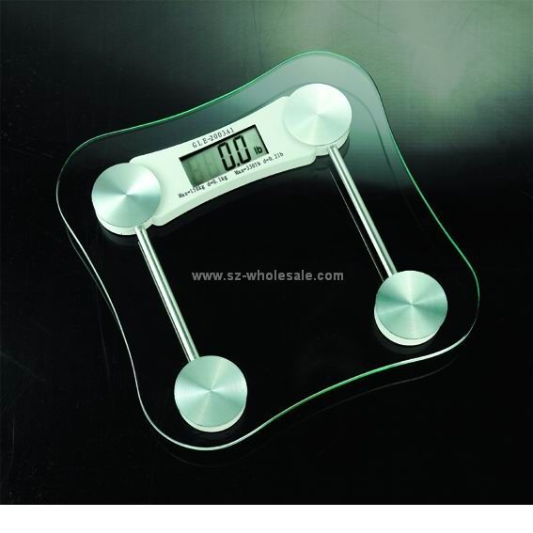
How Much does 1 atom of Hydrogen Weigh?
Could you measure it on a set of scales?
Relative Atomic Mass (A_{r}) is better. This measures masses on a scale which gives the lightest element of all, hydrogen, a mass of 1. (Actually compared to the mass of Carbon 12 so H = 1/12thof 12)
The atomic mass of an element is the number of protons and neutrons in the nucleus.

Slide 4
Atomic Mass of elements
The atoms of each element have a different mass.
Carbon is given a relative atomic mass (RAM) of 12.
The RAM of other atoms compares them with carbon.
Eg. Hydrogen has a mass of only one twelfth that of carbon and so has a RAM of 1.
Below are the RAMs of some other elements.
Element | Symbol | Times as heavy as carbon | R.A.M
Helium | He | one third
Beryllium | Be | three quarters
Molybdenum | Mo | Eight
Krypton | Kr | Seven
Oxygen | O | One and one third
Silver | Ag | Nine
Calcium | Ca | Three and one third
4
12
96
84
16
108
40

Slide 5
The Mole
The relative atomic mass of a substance is its mass in relation to Carbon 12
Carbon is 12 times as heavy as hydrogen, therefore, there are the same number of atoms in 12 grams of carbon as there are in 1 gram of hydrogen
One mole of a substance contains the same number of particles as atoms in 12 grams of carbon 12
One mole of an element is equal to its A_{r}
One mole of a compound is equal to its M_{r}

Slide 6
Avagadro’s Constant
1 mole of hydrogen contains 600 000 000 000 000 000 000 000 atoms
This number is known as the Avagadro constant and is written as 6 x 10²³
Because there are so many atoms in reactions we always talk about moles.
KEY EQUATION: Moles of atoms = mass A_{r}

Slide 7
Worked Example Calculation
How many moles of atoms are there in 36g of Carbon?
Equation: Moles of atoms (n) = mass A_{r}
A_{r} Carbon = 12
Calculation: 36/12 = 3 moles

Slide 8
Another Worked Example Calculation
What is the mass of 5 moles of N atoms?
Rearrange formula: mass = moles x A_{r}
A_{r} Nitrogen = 14
Mass = 5 x 14 = 70g

Slide 9
How Many Moles Of Iron Are In A Nail?
Find the atomic mass of iron
Weigh the iron nail
Use the formula:
Number of moles = mass
A_{r}

Slide 10
Relative atomic mass (R.A.M.)
1. What is the definition of relative atomic mass?
2. Why do some elements have a R.A.M which is a decimal number?
3. What is the symbol for R.A.M.?

Slide 11
Relative atomic mass (R.A.M.)
1. What is the definition of relative atomic mass?
The mass of an atom compared to 1 atom of H
2. Why do some elements have a R.A.M which is a decimal number?
It takes into account the proportions of each isotope
3. What is the symbol for R.A.M.?
A_{r}

Slide 12
Pressure law and Charles’ law
Watch the pressure law demonstration
Carry out Charles’ law experiment.

Slide 13
Extrapolating to absolute zero
Both Charles’ law and the pressure law lead to the concept of an absolute zero of temperature.
Absolute Zero (0 K) is the temperature at which the energy of the particles of a material has its minimum value; this is not zero, as the particles have so-called zero point energy due to quantum effects, which cannot be removed. They still vibrate.
1 T/K = t/°C + 273
Remember real gases turn into liquids and solids before absolute zero is reached. However extrapolating back often gives reasonable values.

Slide 14
Qualitative gas laws
explain how a change in volume results in a change in the frequency of particle collisions with the container and how this relates to a change in pressure
explain how a change in temperature results in a change in the frequency of particle collisions with the container and the average force of those collisions and how this relates to a change in pressure

Slide 15
To do
Read p 288&9
Try these questions
P 289 q1
P291 q 2&3

