Slide 1
Modern Physics
Charged particles

Slide 2
Learning outcomes Candidates should be able to:
(a) show an understanding of the main principles of determination of e by Millikan’s experiment
(b) summarise and interpret the experimental evidence for quantisation of charge
(c) describe and analyse qualitatively the deflection of beams of charged particles by uniform electric and uniform magnetic fields
(d) explain how electric and magnetic fields can be used in velocity selection
(e) explain the main principles of one method for the determination of v and e/m for electrons.

Slide 3
Aims
Describe Thompson’s experiment
Explain how a velocity selector works
Describe Millikan’s experiment
Explain how the results of Millikan’s experiment lead to the concept of quantized charge.

Slide 4
Thompson’s Experiment
Video 1
Video 2
Simulations
http://www.hscphysics.edu.au/resource/template.swf
ALTERNATIVE
https://sites.google.com/site/physicsflash/home/thomson

Slide 5
Thomson's calculations can be summarised as
The electric deflection is given by Θ = Eel/mv²
The magnetic deflection is given by φ = Bel/mv
The magnetic field was varied until the magnetic and electric deflections were the same, when Θ = φ and Eel/mv²= Bel/mv.
This can be simplified to give m/e = B²l/HΘ.
The electric deflection was measured separately to give Θ and H, F and l were known, so m/e could be calculated.

Slide 6
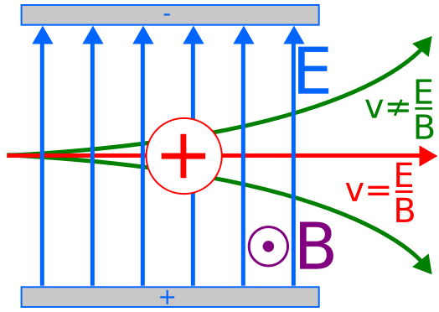
Velocity selector
F_{E}= Eq
F_{B}=Bqv
Bqv=Eq
v=E/B
http://books.google.co.tz/books?id=CTVEAgAAQBAJ&pg=PA179&lpg=PA179&dq=A+level+question+charge+to+mass+ratio&source=bl&ots=5ntFjckCE-&sig=7rBfDPPbiPU4geZSEtHl1UoP0QI&hl=en&sa=X&ei=piDdUoG4EcittAbIsICQBw&ved=0CH4Q6AEwBg#v=onepage&q&f=false
P179 q 8&9

Slide 7
Millikan’s Experiment
http://highered.mcgraw-hill.com/olcweb/cgi/pluginpop.cgi?it=swf::100%::100%::/sites/dl/free/0072512644/117354/02_Millikan_Oil_Drop.swf::Milikan%20Oil%20Drop
Practice -Ppq Jun 08 q7

Slide 8
Fine beam tube
Semi-evacuated electron tube filled with low-pressure helium.
A tangential electron gun.
In the case of a perpendicularly aligned magnetic field, the fundamental electron charge-to-mass ratio can be determined. L
Luminescent beams result from excitation of the helium atoms.

Slide 9
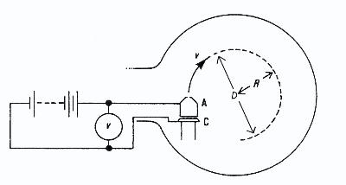
Finding e/m
The fine beam tube

Slide 10
Finding e/m
Centripetal force = mv²/r
Force due to magnetic field F_{B}=Bev
mv²/r = Bev
v² = e/m Bvr
v/Br=e/m
v²/B²r²=e²/m²
Kinetic energy =1/2 mv²
Energy due to electric field E= eV*
1/2 mv² = eV
v²= 2eV/m
*recall definition of electron volt.
(2eV/m)/B²r²=e²/m²
2V /B²r²=e/m

Slide 11
Analysis of results
2V /B²r²=e/m
V= B²er²/2mr²
Plot V as a function of R2 (the data in step 6), and use the slope of the graph to determine the ratio e/m
V= B²er²/2mr²
Compare to y=mx+c
y=V
x=r²
c=0
m= B²e/2m or B²/2 * e/m

Slide 12
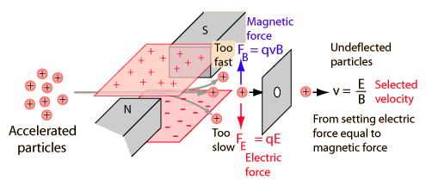
Velocity selector

Slide 13
Velocity selection
For straight beam
Bev=eE
v=eE/Be
v=E/B

