Slide 1
Orbital motion

Slide 2
Aims
Use Newton’s cannonball analogy
State Kepler’s third law
Derive Keplers third law
Describe geostationary orbits

Slide 3
analyse circular orbits in inverse square law fields by relating the gravitational force to the centripetal acceleration it causes.
The relation T² α d³ should be derived.
show an understanding of geostationary orbits and their application
Students should appreciate the west to east nature of the equatorial orbit as well as the period of rotation.

Slide 4


How far could you kick a dog?
From a table, medium kick.

Slide 5

How far can you kick a dog?
Gravity

Slide 6
Harder kick?

Slide 7
Harder kick
Gravity

Slide 8
Small cannon?
Woof! (help)

Slide 9
Small cannon
Woof! (help)
Gravity

Slide 10
Bigger cannon?

Slide 11
Bigger cannon
Gravity
Gravity

Slide 12
Even bigger cannon?

Slide 13
Even bigger cannon
Gravity
Gravity
Gravity

Slide 14
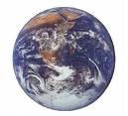
VERY big cannon?

Slide 15
VERY big cannon
Gravity

Slide 16
Humungous cannon?

Slide 17
Dog in orbit!
The dog is now in orbit! (assuming no air resistance of course)

Slide 18
Dog in orbit!
The dog is falling towards the earth, but never gets there!

Slide 19
Dogs in orbit!
The force that keeps an object moving in a circle is called the centripetal force (here provided by gravity)
Gravity

Slide 20
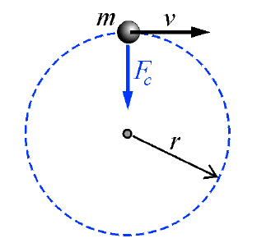
Remember Centripetal Force
Mass (kg)
Linear speed
(m/sec)
Centripetal
force (N)
F_{c} = mv²
r
Radius of path
(m)

Slide 21
Universal Gravitation and Orbital Motion
Key Question:
How strong is gravity in other places in the universe?

Slide 22
Universal Gravitation and Orbital Motion
Gravitational force exists between all objects that have mass.
The strength of the gravitational force depends on the mass of the objects and the distance between them.

Slide 23
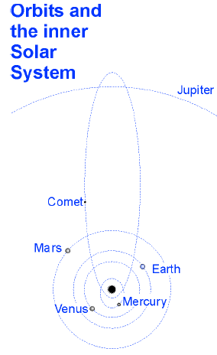
Orbital Motion
A satellite is an object that is bound by gravity to another object such as a planet or star.
If a satellite is launched above Earth at more than 8 kilometers per second, the orbit will be a noncircular ellipse.
A satellite in an elliptical orbit does not move at a constant speed.

Slide 24
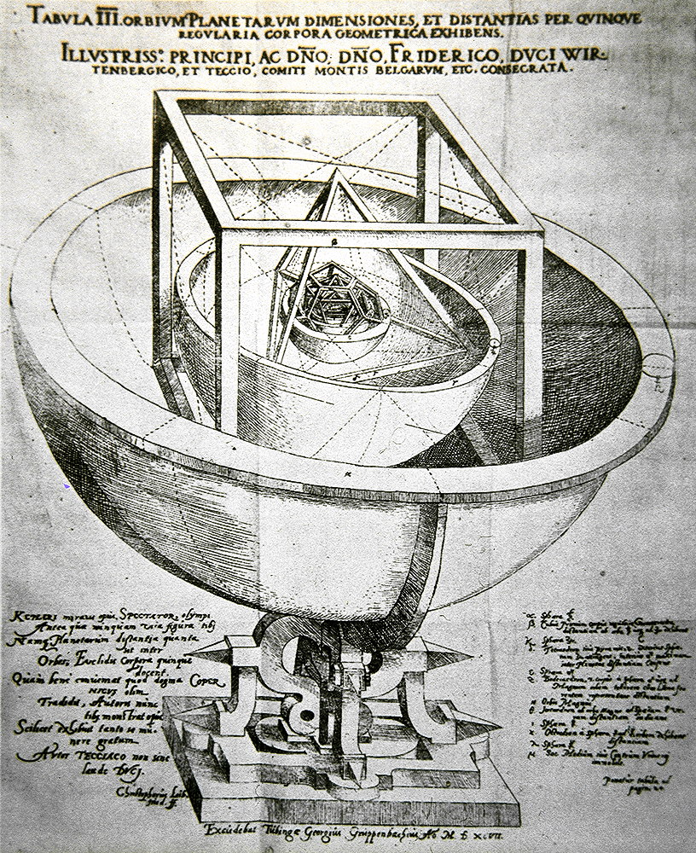
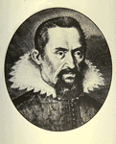
Kepler’s Work
Tycho Brahe led a team which collected data on the position of the planets (1580-1600 with no telescopes).
Mathematician Johannes Kepler was hired by Brahe to analyze the data.
He took 20 years of data on position and relative distance.
No calculus, no graph paper, no log tables.
Both Ptolemy and Copernicus were wrong.
He determined 3 laws of planetary motion (1600-1630).

Slide 25
Kepler’s First Law
The orbit of a planet is an ellipse with the sun at one focus.
A path connecting the two foci to the ellipse always has the same length.

Slide 26
Kepler’s Second Law
The line joining a planet and the sun sweeps equal areas in equal time.
Δt
The planet moves slowly here.
Δt
The planet moves quickly here.

Slide 27
Orbital Period
An ellipse is described by two axes.
  Long – semimajor (a)
  Short – semiminor (b)
The area is πab (becomes πr² for a circle).
The speed is related to the period in a circular orbit.
  v² = GM/r
  (2πr/T)² = GM/r
  T² = 4π²r³/GM
Larger radius orbit means longer period.
Within an ellipse, a larger semimajor axis also gives a longer period.
b
a

Slide 28
Kepler’s Third Law
The square of a planet’s period is proportional to the cube of the length of the orbit’s semimajor axis.
  T²/a³ = constant
  The constant is the same for all objects orbiting the Sun
direction of orbit
The time for one orbit is one period: T
semimajor axis: a

Slide 29
This law relates the time period ‘T’ of a planet’s orbit (its ‘year’) to the distance ‘r’ from the star it is attracted to, e.g. for Earth orbiting the Sun.
We know that the force between the two bodies is…
Kepler’s Third Law
F = GMm r²
We also know that the centripetal force acting on a body in circular motion is given by…
F = mω²r = mv²
r

Slide 30
So equating gives...
However, the angular speed ω is the angle (in radians) per unit time. So in one orbit, the angle is 2π and the time is the time period T. ω = 2π / T
mω²r = GMm r²
Rearranging…
ω² = GM
r³
So…
4π² = GM
T² r³
T² = 4π²
r³ GM

Slide 31
Clearly the closer the planet to the Star, the shorter the time period.
T² = 4π²
r³ GM
Thus for any planet orbiting a star in a circular orbit, T² is proportional to r³. Also the ratio T²/r³ is constant. This is known as Kepler’s third law.

Slide 32
Geostationary orbits
We know from Kepler’s third law that the further away a satellite is from the body it is orbiting, the longer its orbital period.
If an orbiting satellite had a period of 24 hours, and you saw it overhead at, say 10.00 am, when would you next see it overhead?
it would next be overhead at 10.00 am the next day.
Because both the Earth would have completed one rotation in the same time it took the satellite to complete one orbit, Such a satellite is said to be geosynchronous.)
If you wanted the satellite to remain directly overhead (i.e. above a fixed point on the Earth) at all times (not just once per day) where on the Earth would you have to be?
on the equator
[All satellites (in circular orbits) orbit around the centre of the Earth. The only points on the Earth’s surface that orbit around the centre of the Earth are those on the equator. Thus, you would have to be on the equator.]
If a satellite has a period of 24 hours and orbits above the equator such that it always appears to be above one point on the equator, it is known as a geostationary satellite, and its orbit is a geostationary orbit.

Slide 33
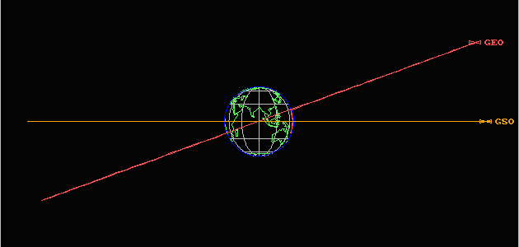
The orbit labelled GEO is geosynchronous, but not geostationary, because the satellite would appear from the equator to wander first north, and then south and then back again over a 24 hour period.
The orbit labelled GSO is geostationary.

Slide 34
So what?
Geostationary satellites are predominantly used for communications.
Satellite TV companies use geostationary satellites to cover a constant area on the Earth’s surface – hence you point your satellite dish receiver in the direction of the geostationary satellite.
3 geostationary satellites placed into orbit 120 degrees apart above the equator would be able to cover the entire Earth (except for very near the poles).
Because geostationary satellites have to be launched so high (other satellites orbit as low as a few hundred km), the energy and costs required for launching a satellite into geostationary orbit are high.

Slide 35
Kinetic Energy of a Satellite
Again by equating the two equations for force acting on an orbiting body, we can now derive a formula for its KE. This time we write the centripetal force formula using v instead of ω:
Rearrange and multiply both sides by 1/2 …
So, for a satellite…
mv² = GMm
r r²
½ mv² = GMm
2r
KE = GMm
2r

Slide 36
Potential Energy of a Satellite
We already know that the potential energy must be given by…
Total Energy of a Satellite
Total Energy = KE + PE
E_{p} = - GMm r
Total Energy = GMm - GMm
2r r
Total Energy = - GMm
2r

Slide 37
Energy
KE
Distance r
Total E
PE

