Slide 1
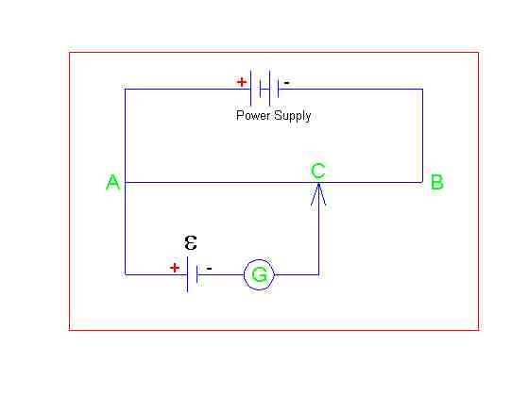
Null methods
A B is a length of wire
C is a moveable contact
G is a galvanometer
E is a source of emf

Slide 2
Calibration
Using a standard cell (known emf)
C is adjusted until Galvanometer reads zero
At this point the circuit is balanced (p.d. across AC = emf).
The length AC is measured
Emf / L gives a value in Vm-1
The circuit is calibrated

Slide 3
Measuring emf
Place unknown emf at E
Find balance point as before
Measure length from A to C (L)
Multiply L by callibration factor to find unknown E.

Slide 4
Electric Fields

Slide 5
Learning outcomes You should be able to:
(a) show an understanding of the concept of an electric field as an example of a field of force and define electric field strength as force per unit positive charge acting on a stationary point charge
(b) represent an electric field by means of field lines
(c) recall and use E =V/d to calculate the field strength of the uniform field between charged parallel plates in terms of potential difference and separation
(d) calculate the forces on charges in uniform electric fields
(e) describe the effect of a uniform electric field on the motion of charged particles

Slide 6
Aims
Define electric field strength
Draw electric field patterns for various situations
Solve problems using E=V/d
Calculate force on a charge in a uniform field.
Describe the motion of particles in uniform fields

Slide 7
Coulomb’s law
What determines the size of the electric force?
The force will be dependent upon the sizes of the charges, and their separation.
In fact the force follows an inverse square law, and is very similar in form to Newton’s Law of Universal Gravitation It is known as Coulomb’s law, and it is expressed as:
F=kQ₁Q₂/r²
where F = force on each charge (N)
Q₁ and Q₂ are the interacting charges (C)
r = separation of the charges (m)
The k is a constant of proportionality (like G in Newton’s Law of Universal Gravitation). In a vacuum, and to all intents and purposes, in air, we have
k = 9.0 x 10⁹ (units?)
N m² C⁻² (units obtained by rearranging the original equation)

Slide 8
Putting it to work
A2 only try worksheet

Slide 9
Field strength
How is field strength defined at a point in the gravitational field?
As the force per unit mass placed at that point in the field
What are the units
N kg⁻¹.
What would therefore be the natural way to extend this definition to the electric field?
As the force per unit charge.
Thus it would have units of N C⁻¹.)
We thus define the electric field strength at a point in a field as:
E = F/Q
where E = electric field strength (N C⁻¹)
F = force on charge Q at that point if the field

Slide 10
Important notes
The field strength is a property of the field and not the particular charge that is placed there.
For example, at a point where the field strength is 2000 N C⁻¹, a 1 C charge would feel a force of 2000 N whereas a 1 mC charge would feel a force of 2 N; the same field strength, but different forces due to different charges.
The field strength is a vector quantity. By convention, it points in the direction that a positive charge placed at that point in the field would feel a force.

Slide 11
Putting it to work

Slide 12
Field lines
Electrical charges exert forces upon one another. Just as with gravity, these forces can be understood in terms of fields that exist between ‘charged’ particles.
What is the basic law of force between charges?
Like charges repel, unlike charges attract.
How do these forces occur if, as usual, the charges are not in contact?
The presence of electric fields between the charges
How do we usually represent these fields?
With field lines or lines of force.

Slide 13
Which way now?
What direction do we put on gravitational field lines?
All forces are attractive and so putting a direction on the field line is unambiguous – it gives the direction a mass will feel a force at a point in a field.
Why can’t we do this for electric fields?
Because both attraction AND repulsion can occur in an electric field
So what do we do about it?
We introduce the following convention:
The direction of a field line in the electric field is the direction of the force on a small POSITIVE charge.
Thus if a positive charge is placed at a point in a field, it will feel a force in the direction of the field line at that point, but if a negative charge is placed there, it will feel a force in the OPPOSITE direction to the direction of the field line at that point.

Slide 14
Field lines around opposite charges

Slide 15
Field lines around like charges

Slide 16
Field lines and charged plates
Two parallel plates
Plate and point charge

Slide 17
Remember these
Field lines....
Never start or stop in empty space – they stop or start either on a charge or “at infinity”.
Never cross – if they did, a small positive charge placed there would feel forces in different directions, which could be resolved into the one true direction of the field line there.
The density of field lines on a diagram is indicative of the strength of the field.
The second diagram above also shows a point exactly between two like charges where no field exists (since the forces on a charge placed there would be exactly equal and opposite in direction). Such a point is called a neutral point.

Slide 18
EXTENSION

Slide 19
Equipotentials
points of equal potential in the field
in other words, no work is done in moving a charge on an equipotential surface.
Equipotential surfaces are perpendicular to field lines.
Any electrical conductor is an equipotential surface.
Field lines always meet conductors at right angles (see the fourth field diagram in the last section).

Slide 20
Equipotential examples I

Slide 21
Equipotential examples II
(resourcefulphysics.org)

