Slide 1
Potential dividers
(j) show an understanding of the use of a potential divider circuit as a source of variable p.d.
(k) explain the use of thermistors and light-dependent resistors in potential dividers to provide a potential difference that is dependent on temperature and illumination respectively
(l) recall and solve problems using the principle of the potentiometer as a means of comparing potential differences.

Slide 2
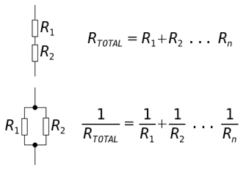
Combining Resistors

Slide 3
In series
The first diagram shows three resistors connected in series
There are 3 facts that you should know for a series circuit:
the current through each resistor in series is the same
the total p.d., V across the resistors is the sum of the p.d.s across the separate resistors, so: V = V_{l} + V₂ + V₃
the combined resistance R in the circuit is the sum of the separate resistors

Slide 4
Equivalent resistance
Suppose we replace the 3 resistors with one resistor R that will take the same current I when the same p.d. V is placed across it
R = R_{l} + R₂ + R₃
We know that for the resistors in series:
V = V_{l} + V₂ + V₃
But for any resistor: p.d. = current x resistance (V = I R).
If we apply this to each of our resistors, and remember that the current through each resistor is the same and equal to I, we get:
IR = IR_{l}+IR₂+IR₃
If we now divide each term in the equation by I,
we get:
R = R₁ + R₂ + R₃

Slide 5
In parallel
We now have resistors connected in parallel:
There are 3 facts that you should know for a parallel circuit:
the p.d. across each resistor in parallel is the same
the current in the main circuit is the sum of the currents in each of the parallel branches, so:
I = I₁ + I₂ + I₃

Slide 6
the combined resistance R is calculated from the equation: 1/R=1/R1+1/R2 …….
Suppose we replace the 3 resistors with one resistor R that takes the same total current I
When the same p.d. V is placed across it.
I = I₁+I₂+I₃
But for any resistor, current = p.d. = resistance (I = V/R ).
If we apply this to each of our resistors, and remember that the
p.d. across each resistor is the same and equal to V,
we get: V/R=V/R₁ + V/R₂ + V/R₃
Now we divide each term by V, to get:
1/R=1/R₁ + 1/R₂ + 1/R₃
You will find that the total resistance R is always less than the smallest resistance in the parallel combination.

Slide 7
Ideal ammeters
In order to measure the current, an ammeter is placed in series, in the circuit.
What effect might this have on the size of the current?
The ideal ammeter has zero resistance, so that placing it in the circuit does not make the current smaller.
Real ammeters do have very small resistances ‑ around 0.01 Ω.

Slide 8
Ideal voltmeters
A voltmeter is connected in parallel with a component, in order to measure the p.d. across it.
Why can this increase the current in the circuit?
Since the voltmeter is in parallel with the component, their combined resistance is less than the component's resistance.
The ideal voltmeter has infinite resistance and takes no current.
Digital voltmeters have very high resistances, around 10 MΩ, and so they have little effect on the circuit they are placed in.

Slide 9
A potential divider
The potential divider is one of the most useful circuits
Calculate the voltage across each of its resistors.
For an unloaded potential divider the current through each resistor is the same so the voltage is proportional to the resistance.
This means that the pd across the pair of resistors is divided in the same ratio as the resistors themselves:
R₂
V₂
V_{S}
R₁
V₁

Slide 10
The potential divider formula
V₁ / V₂ = I R₁ / I R₂
or
V₁ / V₂ = R₁ / R₂
if R₁ >> R₂ then V₁ is more or less the supply voltage
If R₁ << R₂ then V₁ is close to 0 V.
You could look at V_{S} as an input to the potential divider and V₁ as an output.
The circuit itself provides a way to tap off a voltage between 0 V and V_{S}.
R₂
V₂
V_{S}
R₁
V₁

Slide 11
Using a Rheostat
This can, of course be done continuously using a rheostat or potentiometer
Observe a variety of these
Rotary potentiometers are used as volume controls in hi-fi systems.
V_{IN}
V_{OUT}

Slide 12
Using a Rheostat
V₁ = IR₁
V_{s}=IR₁+IR₂
V_{s}=I(R₁+R₂)
V₁/V_{s}= IR₁ /I(R₁+R₂)
V₁/V_{s}= R₁ /(R₁+R₂)
The potential divider equation can be derived by rearranging the ratios to give:
V₁ = R₁ / (R₁+R₂) × V_{S}
R₂
V₂
V_{S}
R₁
V₁

Slide 13
To Do
Carry out the experiment
Complete the worksheet
Written report and answers due next lesson

Slide 14
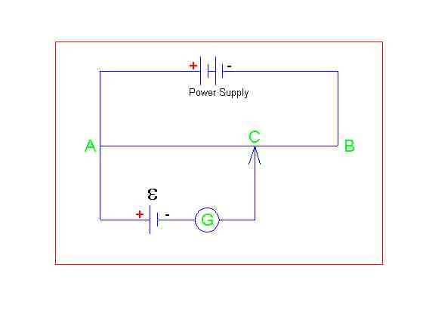
Null methods
A B is a length of wire
C is a moveable contact
G is a galvanometer
E is a source of emf

Slide 15
Calibration
Using a standard cell (known emf)
C is adjusted until Galvanometer reads zero
At this point the circuit is balanced (p.d. across AC = emf).
The length AC is measured
Emf / L gives a value in Vm-1
The circuit is calibrated

Slide 16
Measuring emf
Place unknown emf at E
Find balance point as before
Measure length from A to C (L)
Multiply L by callibration factor to find unknown E.

Slide 17
Extension - The effect of the load on output
What is the effect of loading a potential divider on its output voltage.
Connecting a load across R₁ reduces the output voltage.
This is because the effective resistance in the lower arm of the potential divider is now a parallel combination of R₁ and R _{load} (less than R₁) so a smaller fraction of the voltage is ‘tapped off’.
If R_{load} >> R₁ then there is no significant effect on the output voltage.
Consider what is happening when a lit bulb goes out when “shorted out” by a piece of wire.
Avoid using a current based explanation
Think in terms of potential difference, and resistance.
In the “shorting out” case it was not that “all the current wanted” to take the easier parallel route”, but that the low resistance of the wire in parallel reduced the combination’s total resistance, compared to the rest of the circuit.

Slide 18
Extra task
Further worksheet for the keen and able

