Slide 1
Density
Know the density of some common materials.
Measure the density of a regular solid
Measure the density of an irregular solid
Measure the density of a liquid
Record information in a table

Slide 3
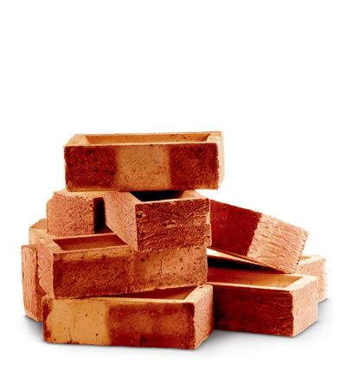
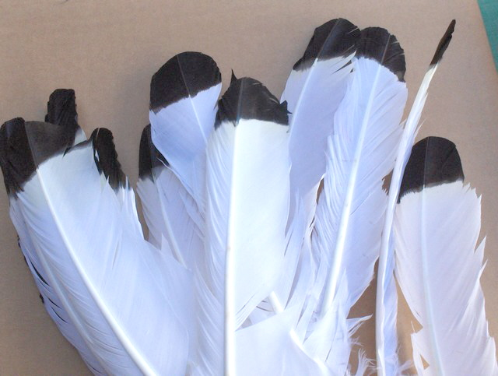
Which is heavier?
5 kg
5 kg

Slide 4
Density
Density is the mass of one cubic centimetre of a substance.
So for example, gold has a density of 19.3 g/cm³. This means one cubic centimetre (cm³) of gold has a mass of 19.3 grams.

Slide 5
The formula!
g/cm³
g
Density = mass
volume
Or using the formula triangle;
m
D x V
cm³

Slide 6
Density of regular shapes
volume = length x width x height
density = mass/volume
mass using a scale
height
width
length

Slide 7
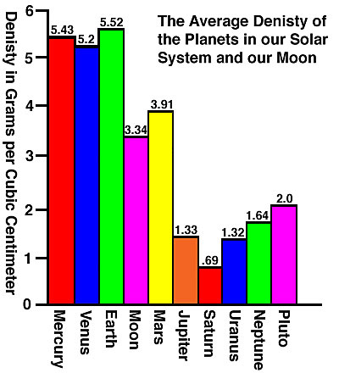
Can you continue to measure your densities?

Slide 8
Extreme Density

Slide 9
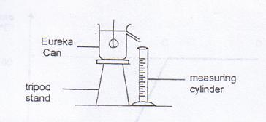
Density of an irregular solid

Slide 10
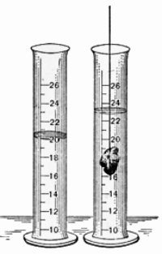
…..Or

Slide 11
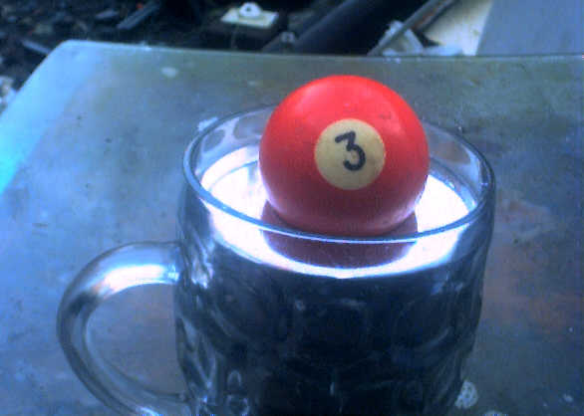
Can you write a sentence about what we have discovered?

Slide 12
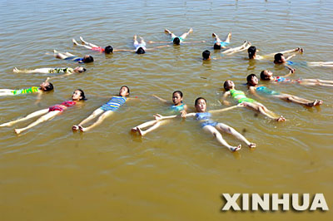
Measuring the density of liquids

Slide 13
Density of water
Volume
Mass of water
Mass of water and cylinder
Mass of cylinder
Density = mass/volume

Slide 14
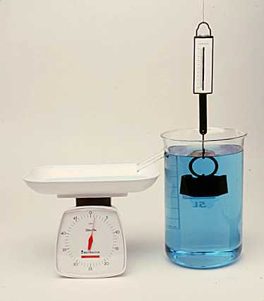
Upthrust
Gently lower a mass on a Newton meter into a beaker of water. Sketch a diagram in your book and write a sentence describing what happens.

Slide 15
What happens if the upthrust is equal to the force of gravity?

Slide 16
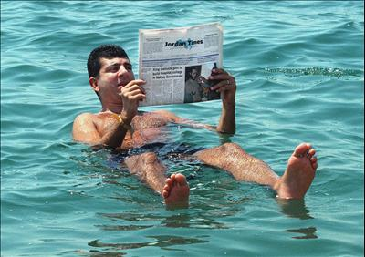
What happens if the upthrust is equal to the force of gravity?

Slide 17
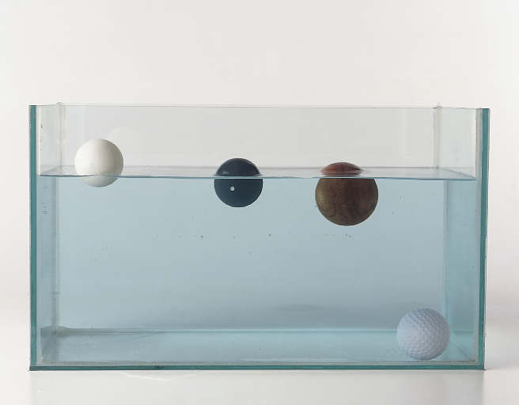
Which will float?

Slide 18
Floating or Sinking?
Density of Bone is 1.8g/cm³
Density of Cork is 0.24g/cm³
Density of Cork is 3.01g/cm³
Density of Ice is 0.90g/cm³
Density of Wood is 0.77g/cm³
Density of Water is 1g/cm³

Slide 19
Bonus experiment
Density tower

Slide 21
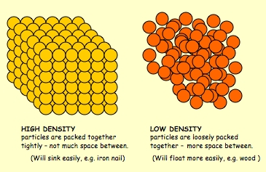
Explaining density
This is only a partial explanation!
What is missing?

Slide 22
symbol | Volume x10-24cm3 | mass/g
H | 49062.5 | 1.67E-27
He | #VALUE! | 6.64E-27
Li | 9572682.5 | 1.15E-26
Be | 3634942.5 | 1.5E-26
B | 1928352.5 | 1.79E-26
C | 1077020 | 1.99E-26
N | 862322.5 | 2.33E-26
O | 678240 | 2.66E-26
F | 392500 | 3.15E-26
Ne | #VALUE! | 3.35E-26
Na | 18312480 | 3.82E-26
Mg | 10597500 | 4.03E-26
Al | 6132812.5 | 4.48E-26
Si | 4179340 | 4.66E-26
P | 3140000 | 5.14E-26
S | 3140000 | 5.32E-26
Cl | 3140000 | 5.88E-26
Ar | 1123840.54 | 6.63E-26
K | 33434720 | 6.49E-26
Ca | 18312480 | 6.65E-26

