Slide 1
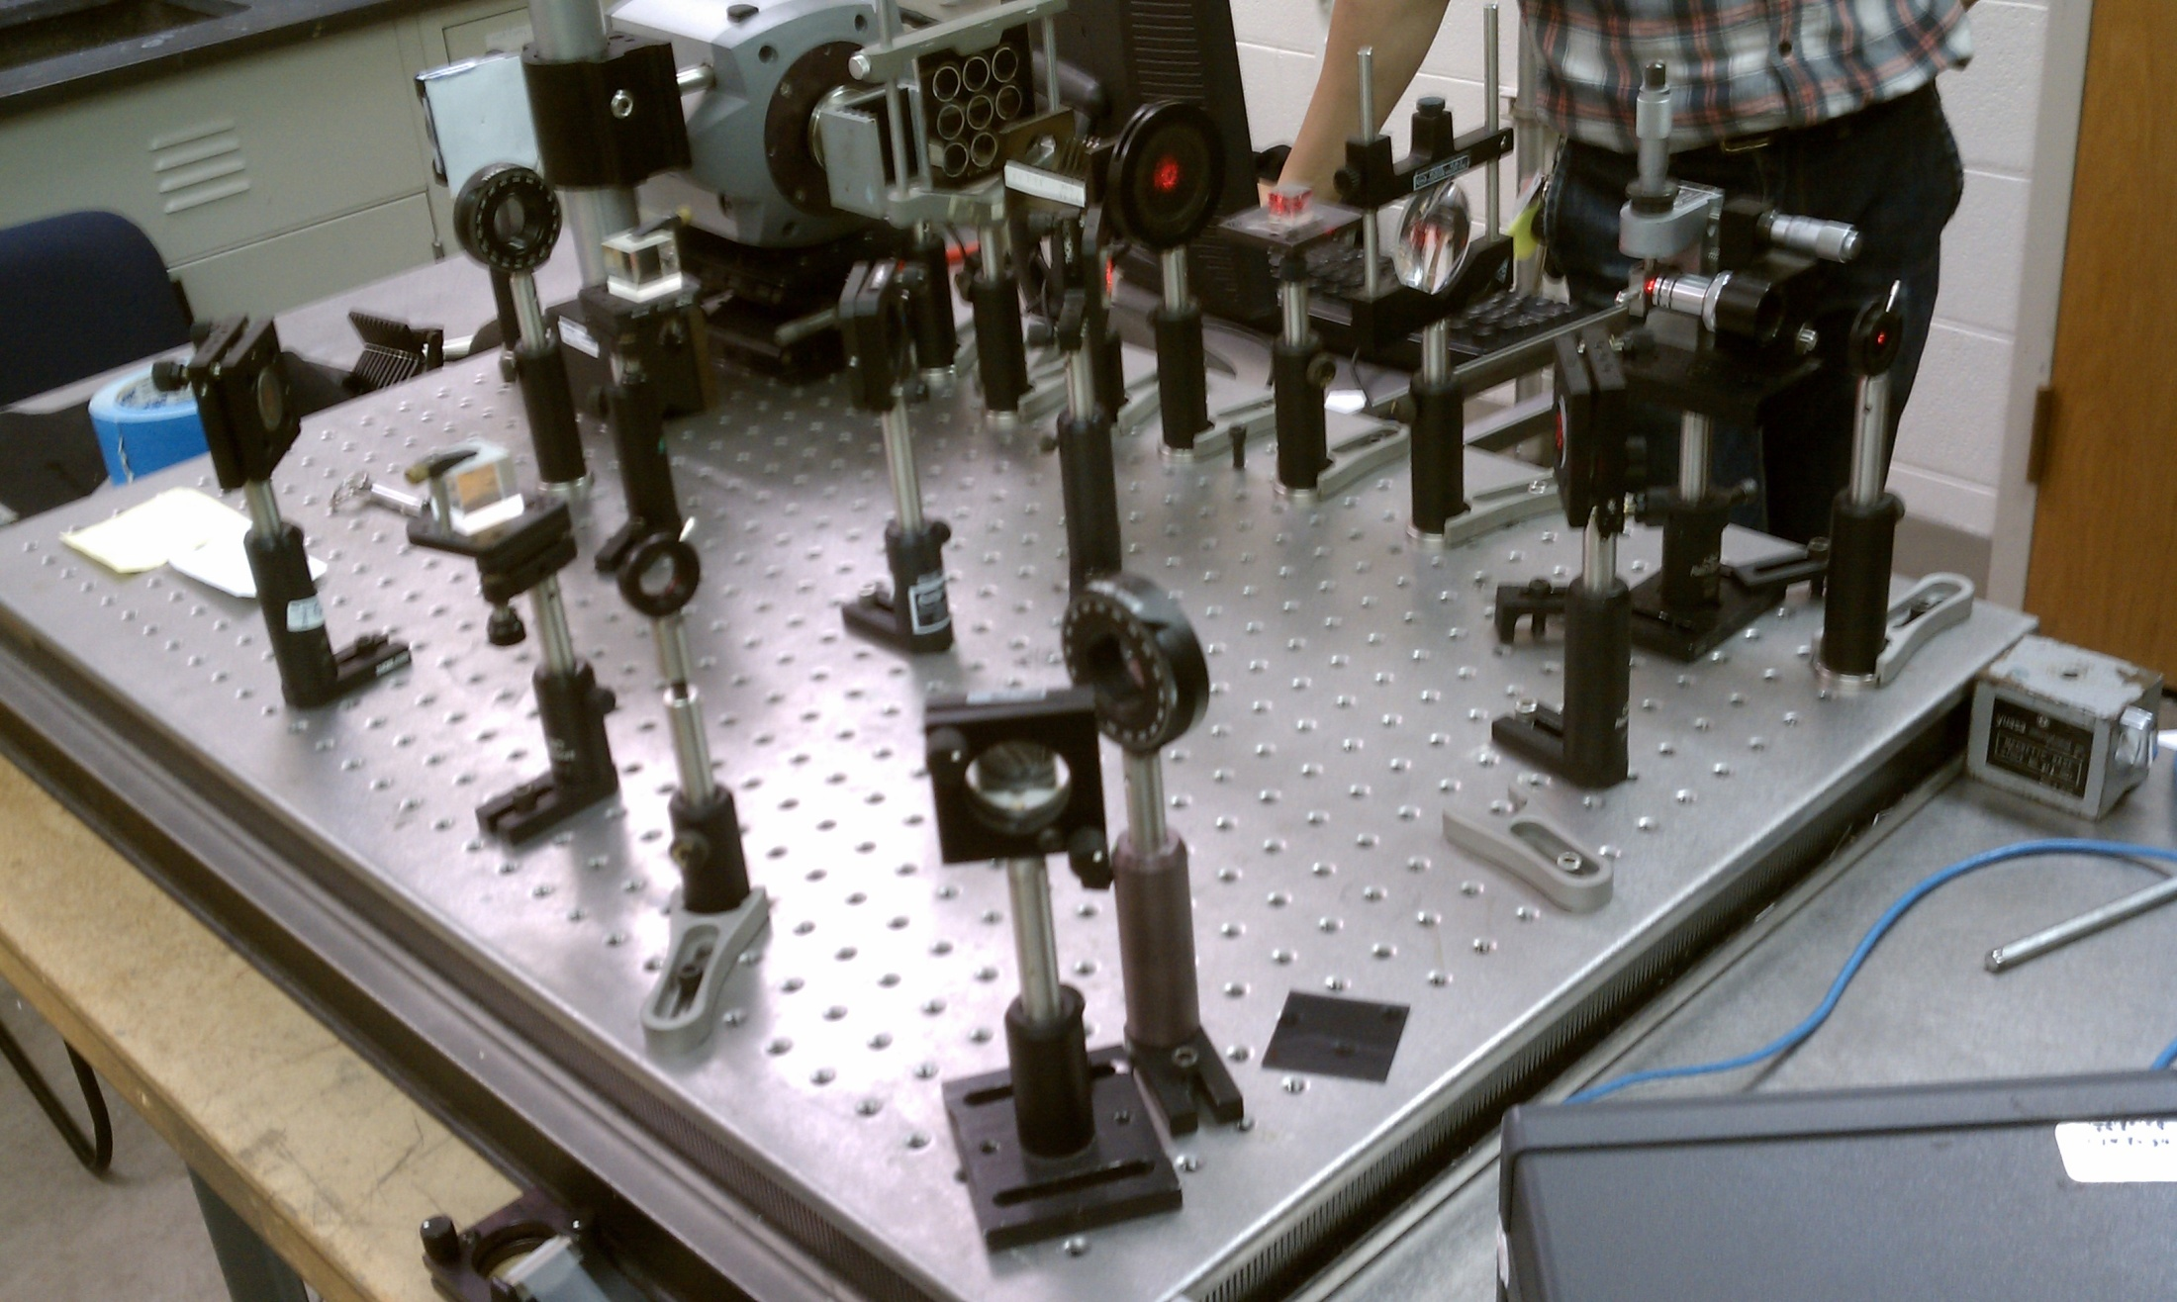
Young’s double slit experiment

Slide 2
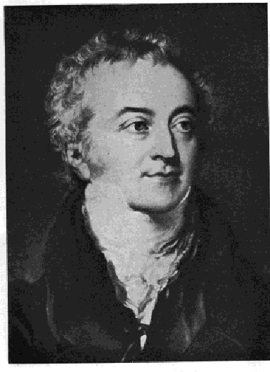
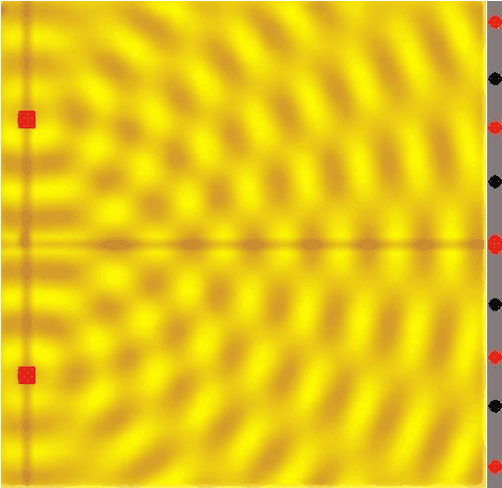
Young’s Double Slit Experiment
YAY!

Slide 3
What is it?
First conducted in 1801 by Thomas Young
Light passed through a barrier with two slits (before it usually passed through a single slit to make the light coherent)
The light diffracted through each slit
Created interference pattern
In order to interfere the light that passes through the slit must be of the same frequency and polarization and it must be coherent

Slide 5
Particles vs. Waves
Particle
Wave
If light acts as a particle, only two slits will appear on the screen
The light will diffract and interfere, making many fringes

Slide 6
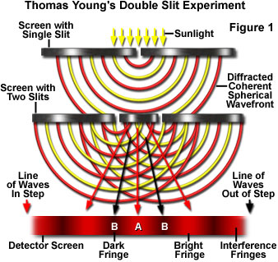
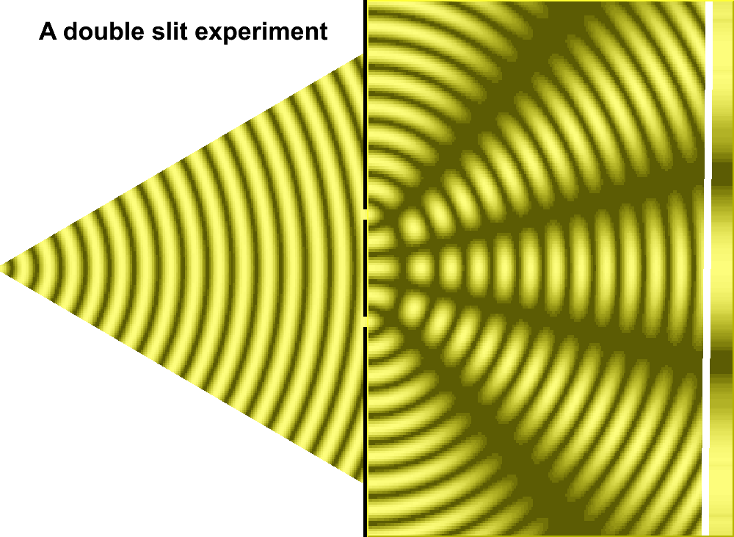
Why is this important?
This proves light acts not only as a particle, but also as a wave!

Slide 7
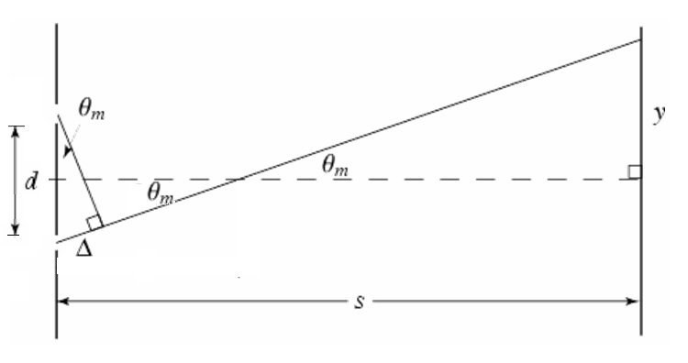
is the path length difference.
constructive interference
destructive interference
n = 0, ±1, ±2, ±3, ±4 etc

Slide 8
Equations for the Fringes
λ/s=w/D
w
w=λD/s

Slide 9
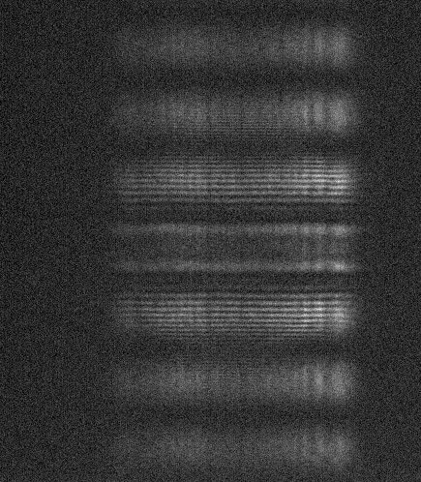
Many Photon Interference
Acquisition Time: .1 sec
Attenuation: 3 optical depths
Amplification: x1

Slide 10
Single Photon
When a single photon is used, wave interference is still present
It is impossible for a photon to act as a wave as it is can only go through one slit
If one slit is blocked, there is no interference

Slide 11
Important Observations
When path of photon is unknown, fringes are observed
When path of photon is known, fringes are not observed

Slide 12
Summary
Young’s Double Slit Experiment
Fringes were observed under high intensity, as well as with only a single photon.

Slide 13
Conclusion
Single photons behaved the same way as the high intensity beam.
In the double slit experiment, the single photon appeared to interfere with itself – going through both slit simultaneously.

Slide 14
Sources
http://www.studyphysics.ca/newnotes/20/unit04_light/chp1719_light/lesson58.htm
http://dev.physicslab.org/asp/applets/doubleslit/default.asp
http://physics.about.com/od/lightoptics/a/doubleslit.htm
http://www.physics.brown.edu/physics/demopages/Demo/modern/demo/7a5520.htm
The book – Seeing the Light
From Jeff, Jacob, Bryce, Edward, and Julie

